Slide 1
ERP/QMS by PMI Aerospace
ERP/QMS by PMI Aerospace

Slide 2
Developed by ERP Consulting LLC. February, 2017 Since 1998 has Matured and Vetted to meet DLA & OEM Requirements
ERP/QMS by PMI Aerospace
Enterprise Resource Planning (ERP) / Quality Management System

Slide 3
ERP / QMS by PMI Aerospace is a business management software suite of integrated applications that your business can use to collect, store, manage and interpret data from many business activities.
ERP/QMS by PMI Aerospace

Slide 4
Includes:
Customer, Vendor, Inventory, Etc.
Maintaining basic customer information
Maintaining basic vendor and vendor certification information
Maintaining basic inventory information
Parts and Configuration Management
Preparing part specifications and inspection reports.
Tracking and viewing part drawings and digital images
Maintaining Standard Routing for parts
Maintaining Process and Skills Information
Conducting Process and Organization Effectiveness Surveys
Job Planning or Quoting System Features
Preparing and printing job quotes.
Establishing Initial Routing and Material Requirements
Estimating Job Costs and Printing Quotes
Tracking Backlogs
ERP/QMS by PMI Aerospace
Notes:
Need to get with Ed on this one.

Slide 5
Inventory Management Features
Issuing Purchase Orders
Tracking inventory, bin locations for inventory storage and report status
Receiving materials
Analyze Subcontractor Effectiveness
Building complex bill-of-material (BOM) structures with a drag-and-drop facility
Generating Kits for those BOM
Customer Order System Features
Preparing job travelers or work orders, routing,
Preparing a certificate of conformance for materials purchased or work done
Reviewing backlog status
Entering and reporting time for work done

Slide 6
Quality System Features
Tracking concerns and problems with the management system.
Issuing & Tracking corrective actions, preventive actions, nonconforming product and internal audits
Tracking all calibration, internal calibration measurements, preventive maintenance and barcode readers
Tracking document and revisions. The ISO9001-2000 international quality standard element 4.2 (Documentation Requirements) ranks high in the top 5 elements causing failure of the certification audit. ERPQMS2011 allows you to implement your own documents numbering system, track revisions and notify document users.
Risk Analysis using FMEA
RCA (Root Cause Analysis

Slide 7
ERP / QMS by PMI Aerospace will run on Microsoft Windows 7, 8.1, or 10. With Microsoft Office Access you can customize your reports for your business needs. Software will run stand-alone with a Microsoft Access Runtime Engine provided with the software.
Price starts at $8995.00 which includes all modules. Custom Installation and/or Training as per your individual needs is available.
Software has help files and tutorials embedded.
ERP/QMS by PMI Aerospace

Slide 8
ERP / QMS by PMI Aerospace
Main Menu
ERP/QMS by PMI Aerospace

Slide 9
ERP / QMS by PMI Aerospace
Customers, Vendors, Inventory, etc. Menu
ERP/QMS by PMI Aerospace

Slide 10
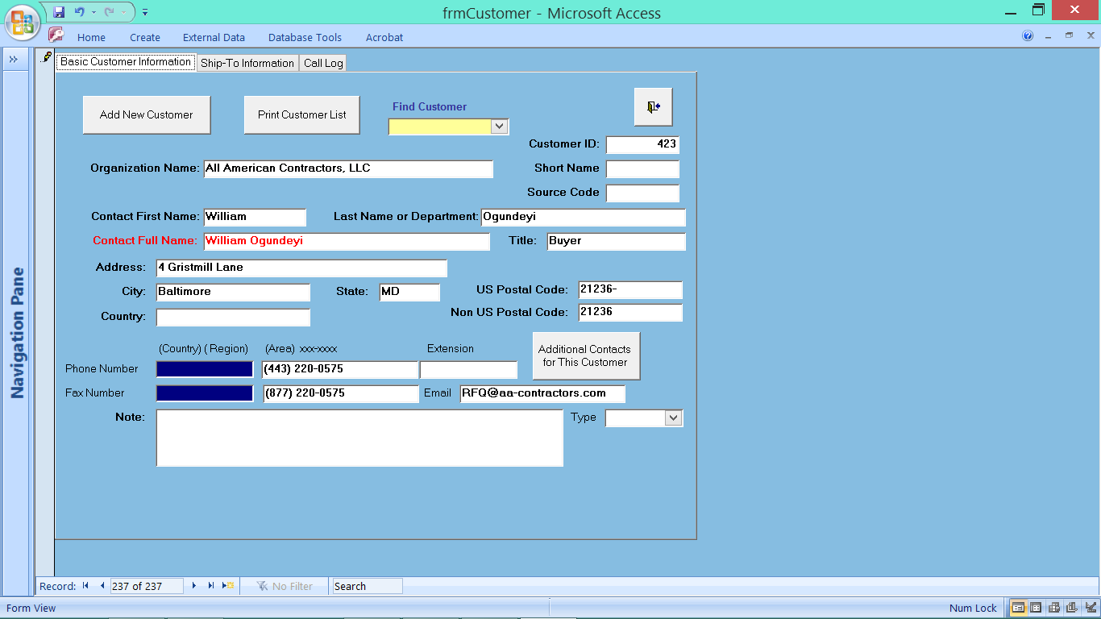
ERP / QMS by PMI Aerospace
Customers, Vendors, Inventory, etc. Menu / Customers Screen
ERP/QMS by PMI Aerospace

Slide 11
ERP / QMS by PMI Aerospace
Customers, Vendors, Inventory, etc. Menu / Customers Screen
Tabs at the top allow you to navigate without leaving the current topic
ERP/QMS by PMI Aerospace

Slide 12
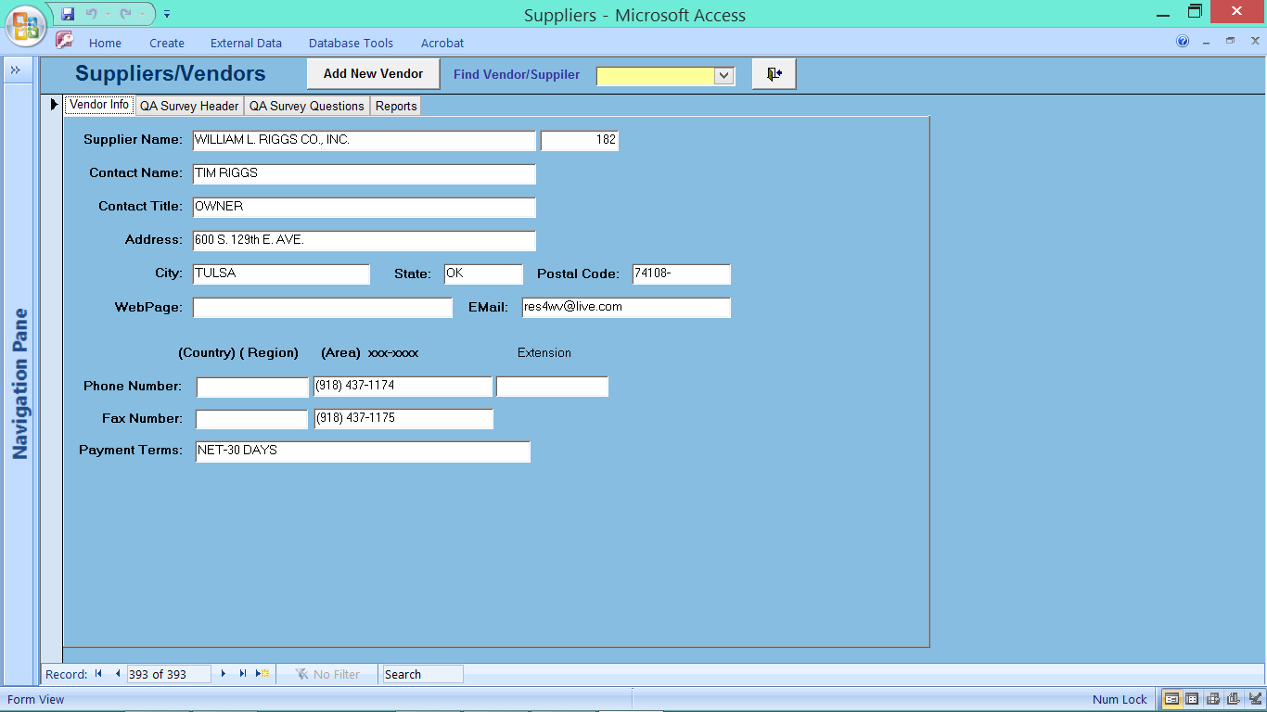
ERP / QMS by PMI Aerospace
Customers, Vendors, Inventory, etc. Menu / Suppliers/Vendors Screen
ERP/QMS by PMI Aerospace

Slide 13
ERP / QMS by PMI Aerospace
Customers, Vendors, Inventory, etc. Menu / Suppliers/Vendors Screen
ERP/QMS by PMI Aerospace

Slide 14
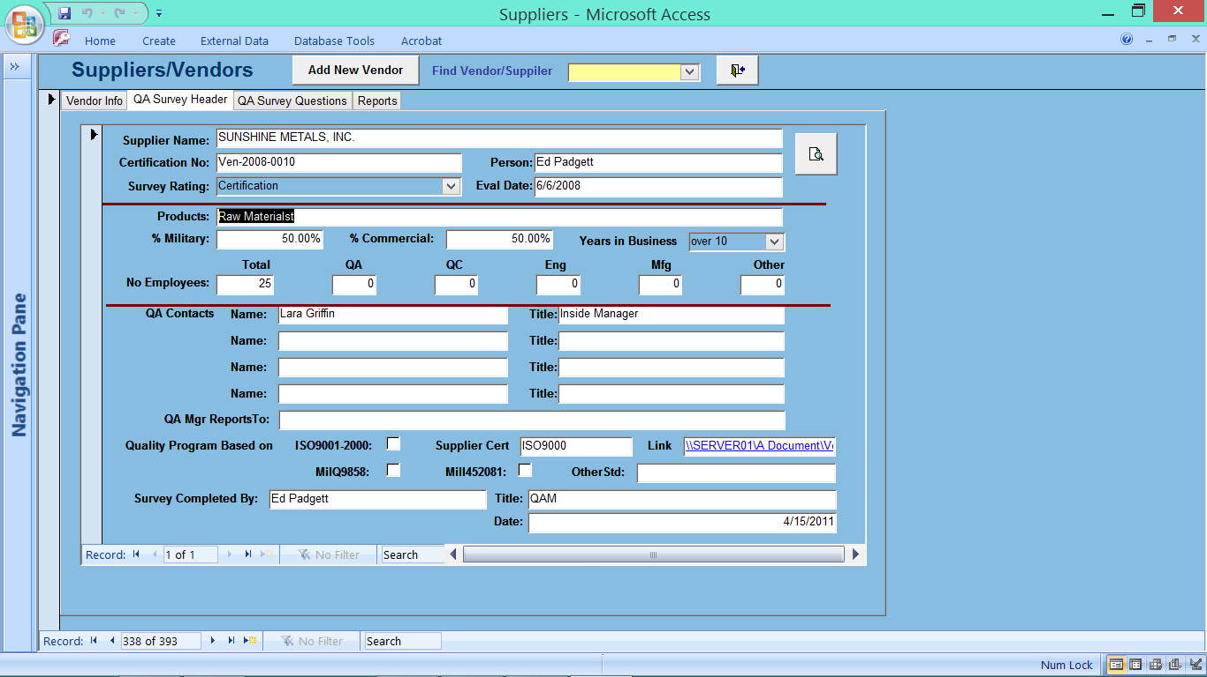
ERP / QMS by PMI Aerospace
Customers, Vendors, Inventory, etc. Menu / Suppliers/Vendors Screen
Moving on to the QA Survey Header tab
ERP/QMS by PMI Aerospace

Slide 15
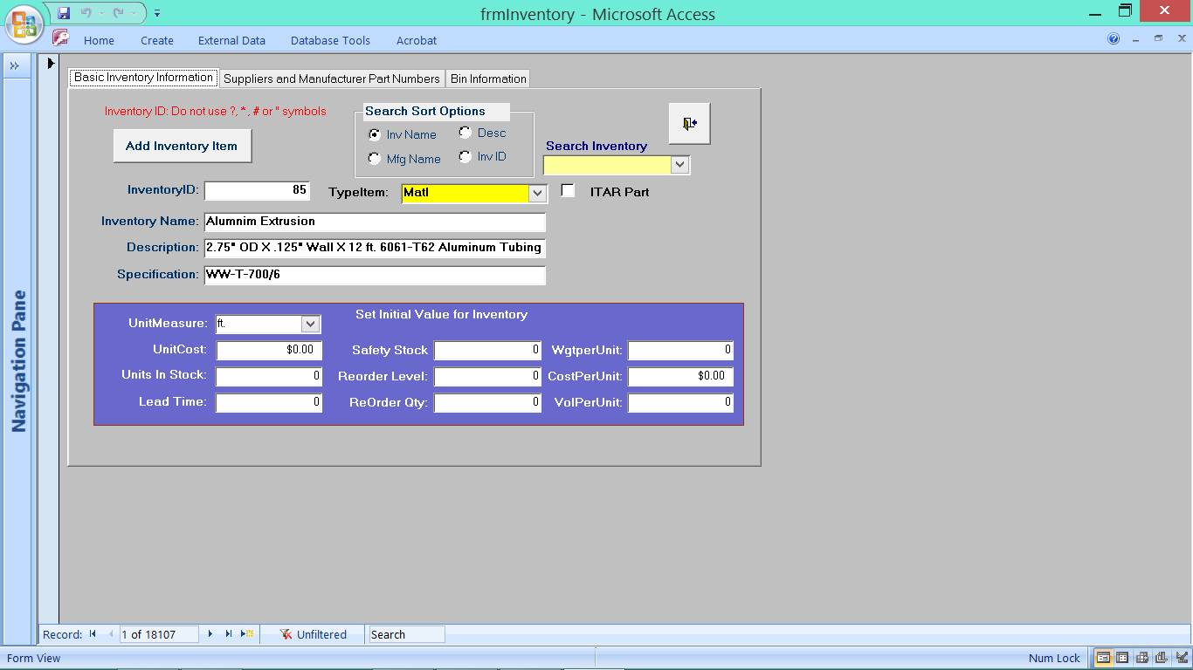
ERP / QMS by PMI Aerospace
Customers, Vendors, Inventory, etc. Menu / Inventory Items Screen
Inventory Form showing type, location, ITAR
ERP/QMS by PMI Aerospace

Slide 16
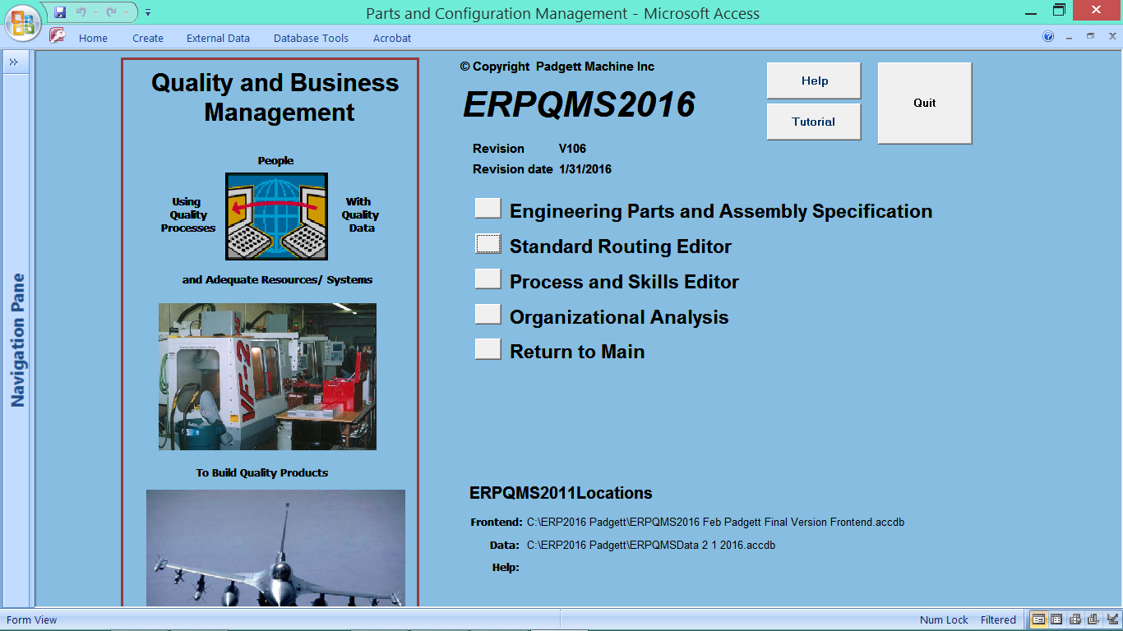
ERP / QMS by PMI Aerospace
Parts and Configuration Management Menu
ERP/QMS by PMI Aerospace

Slide 17
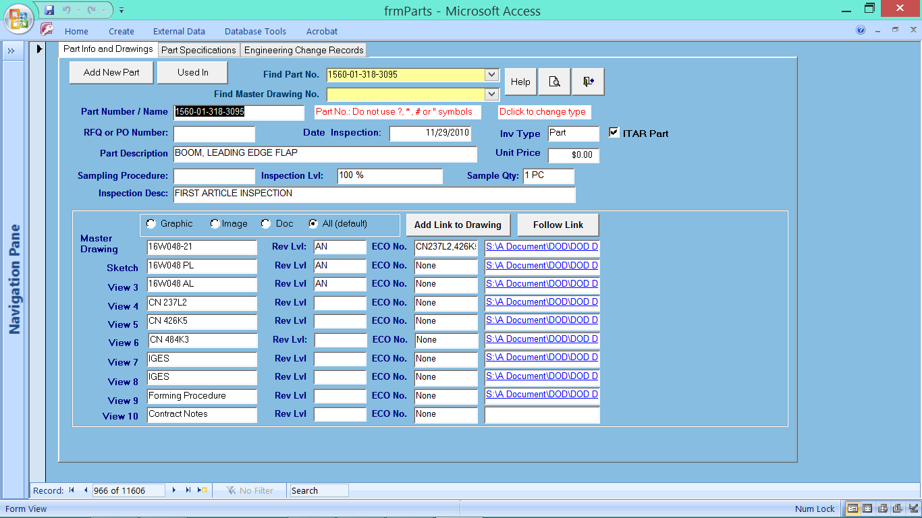
ERP / QMS by PMI Aerospace
Parts and Configuration Management Menu / Engineering Parts and Assembly Specifications
Part#, DWG#. REV#, Part Disc., Hyper to DWG which makes all data available across the network…
ERP/QMS by PMI Aerospace

Slide 18
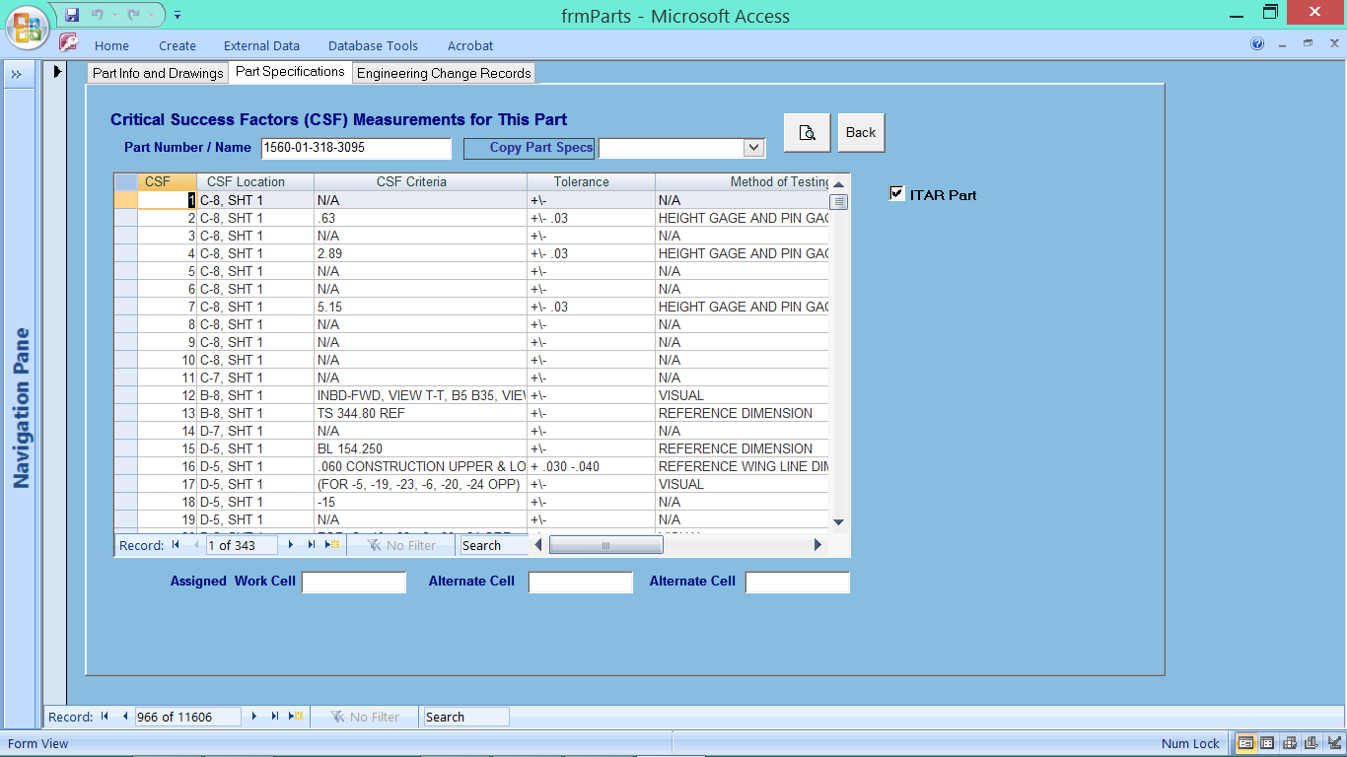
ERP / QMS by PMI Aerospace
Parts and Configuration Management Menu / Part Specifications
Entry Form for Numbered Dimensions with Tolerances and Measurement Instrument
ERP/QMS by PMI Aerospace

Slide 19
ERP / QMS by PMI Aerospace
Parts and Configuration Management Menu / Engineering Parts and Assembly Specifications
Part#, DWG#. REV#, Part Disc., Hyper to DWG which makes all data available across the network…
ERP/QMS by PMI Aerospace

Slide 20
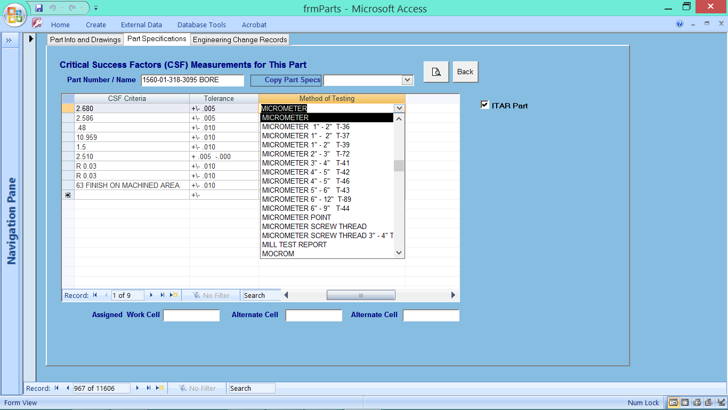
ERP / QMS by PMI Aerospace
Parts and Configuration Management Menu / Part Specifications
Example of Dropdown Field for Inspection Device and ID Number
ERP/QMS by PMI Aerospace

Slide 21
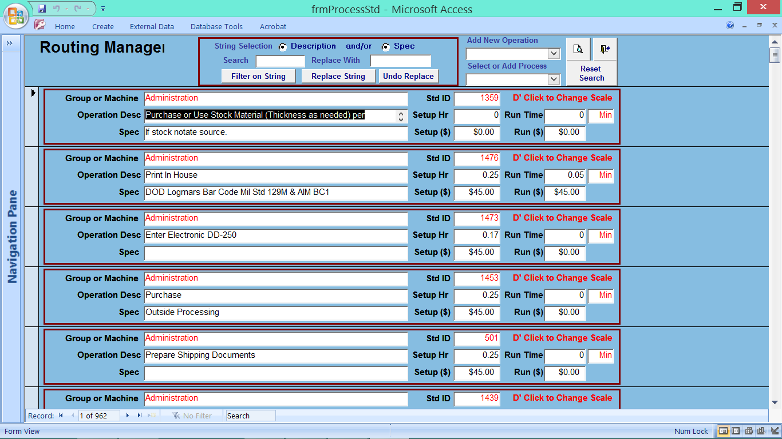
ERP / QMS by PMI Aerospace
Parts and Configuration Management Menu / Standard Routing Editor
Example of Dropdown Field for Inspection Device and ID Number
ERP/QMS by PMI Aerospace

Slide 22
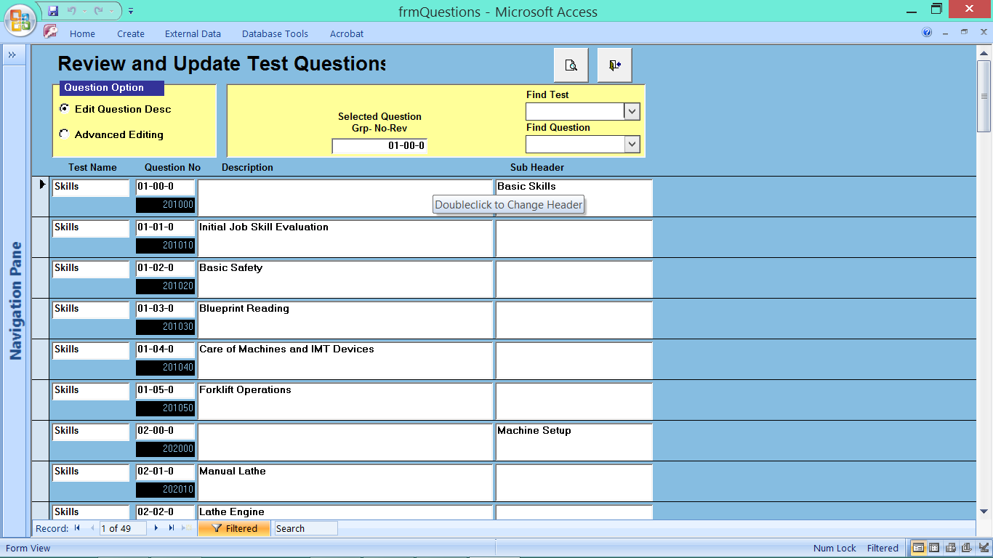
ERP / QMS by PMI Aerospace
Parts and Configuration Management Menu / Process and Skills Editor
Skills Questions Database for new Employee, printable and online
ERP/QMS by PMI Aerospace

Slide 23
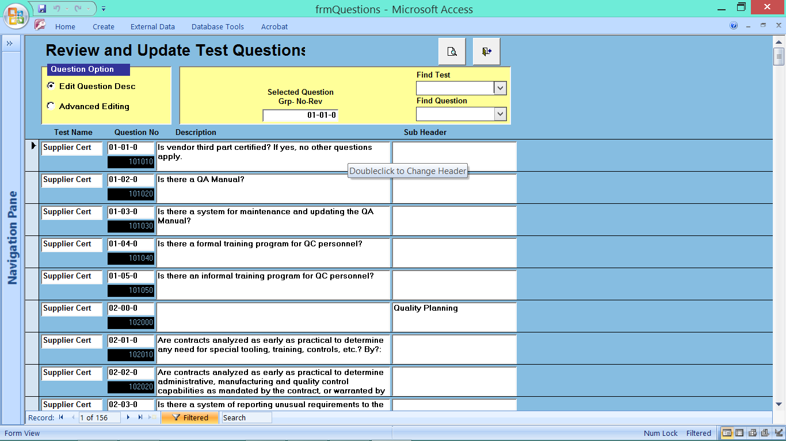
ERP / QMS by PMI Aerospace
Parts and Configuration Management Menu / Process and Skills Editor
Questionnaire for New Vendors, Printable and Online
ERP/QMS by PMI Aerospace

Slide 24
Analysis of a Specific Vendor for conformance

Slide 25
TAB: Quote System

Slide 26
Quote Form for Customer, Loading of parts that leads to prepare bid TAB for pricing

Slide 27
Form prepare Bid with Operations, Materials, Subcontractor pricing, Components as shown on the next 4 slides by pressing the review bid button calculates all 4 fields based on productivity %, overhead, target profit, tax, which generates the projected price for qty defined

Slide 28
On the fly you can change to a different Qty and system calculates the fixed costs such as a 3 hour setup by the new qty and asks if you need to adjust material qty and values

Slide 29
You can print a single part, multiple parts within a single customers request, multiple qty’s, and handle assemblies during the bid process

Slide 30
Materials Form for pricing, per ea, per lb, per ft, per each options

Slide 31
Process Load for Admin, machine opps, operator opps, outside processing opps, inspection opps, quality requirements, coatings, NDT testing, packaging, shipping, with selection from drop down field called routing.

Slide 32
Accessing the dropdown box to load routing with preset values for setup time and base run time that can be changed on the fly based on the job being quoted You can copy an existing similar quote such as a similar dash number or from a part built.

Slide 33
Example in the drop down field for selecting a Lathe Set time and runtime per opp

Slide 34
Sub Contractor Field add from the bid routing field

Slide 35
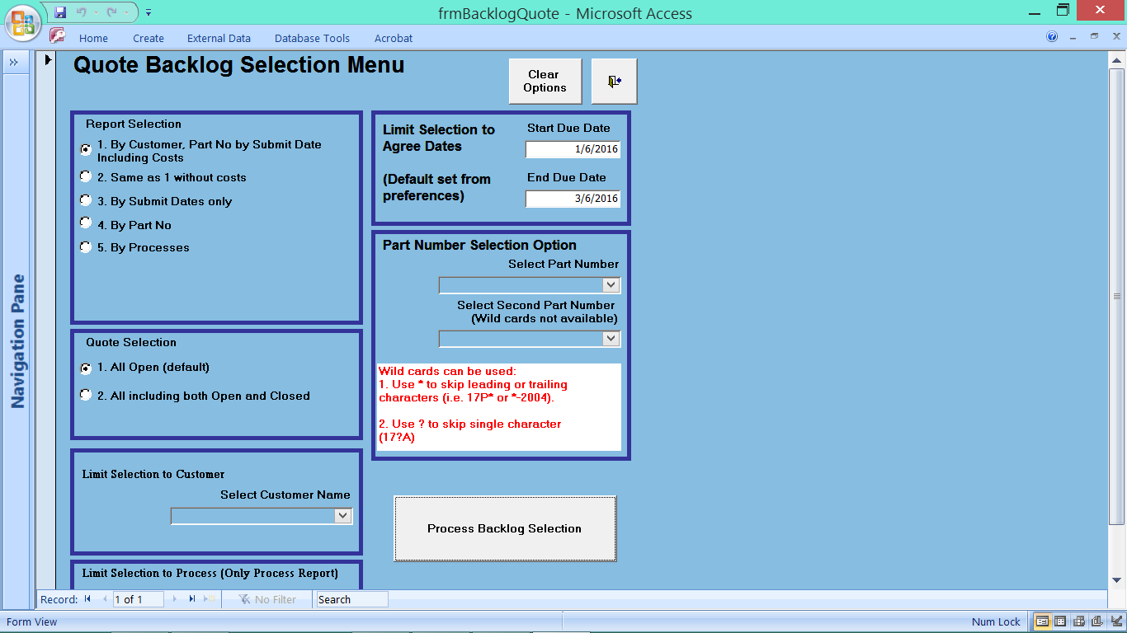
Tab to generate a report of processes bid with variable time frame

Slide 36
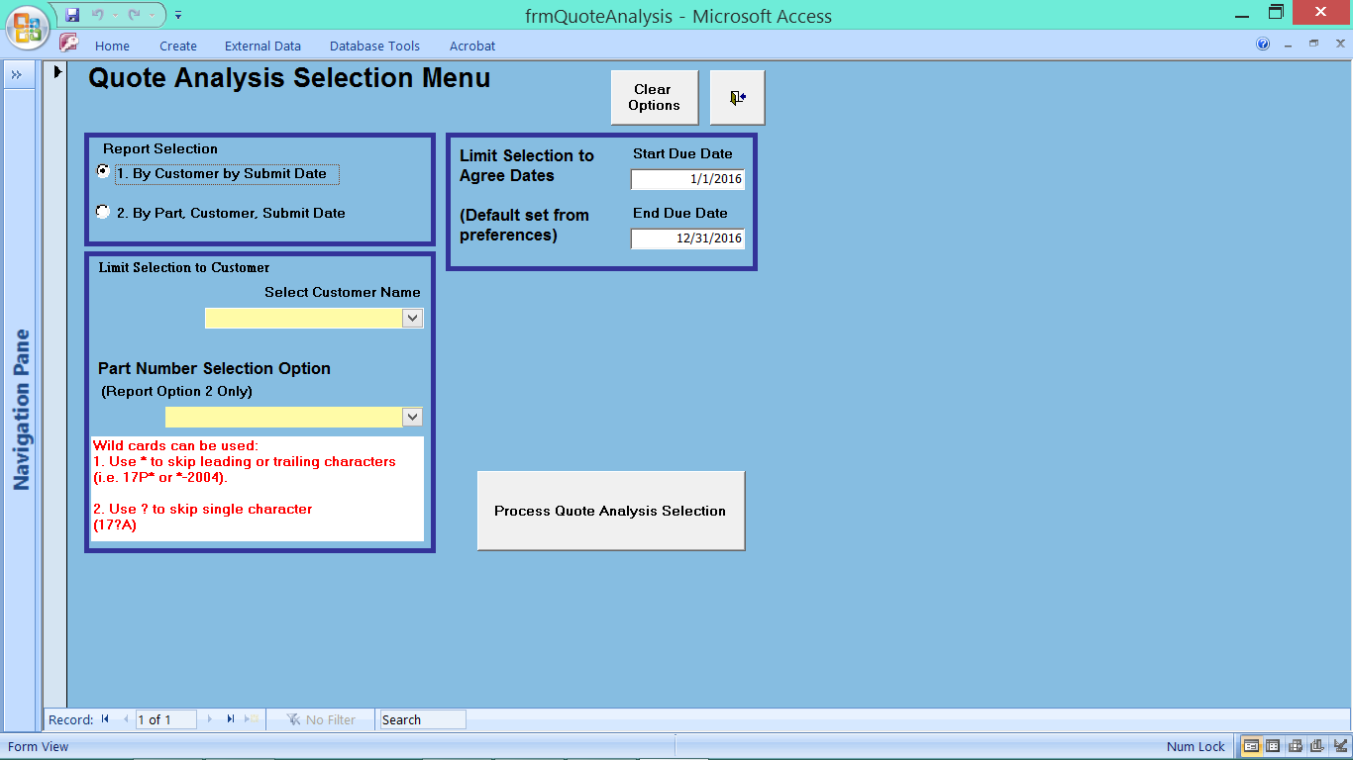
Tab to review bids with dollar amounts aligned by customer for defined timelines.

Slide 37
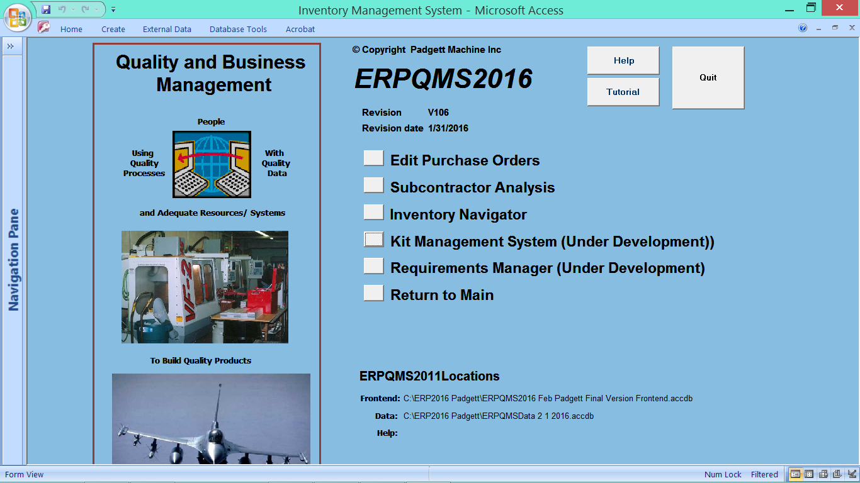
Procurement to Venders, Sub contractor Analysis, Inventory,

Slide 38
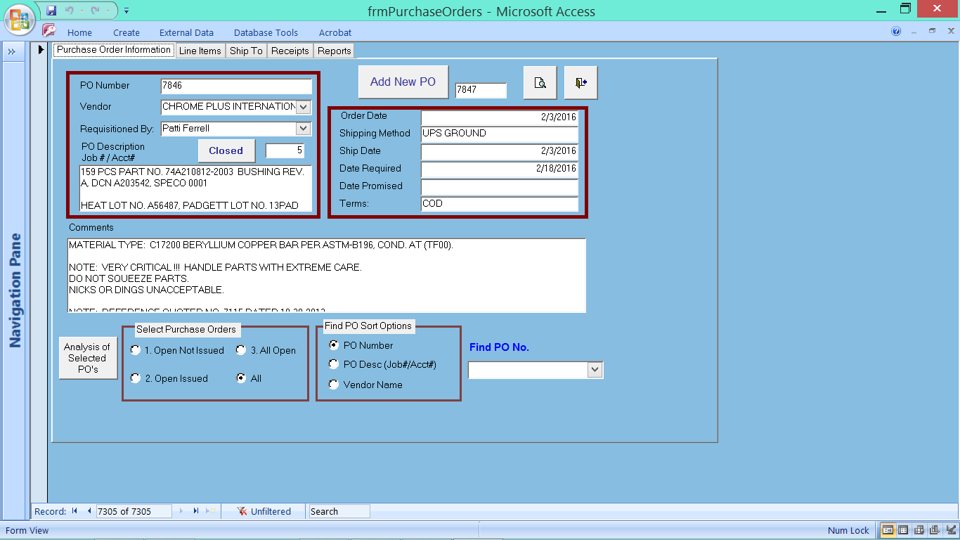
Purchasing Form

Slide 39
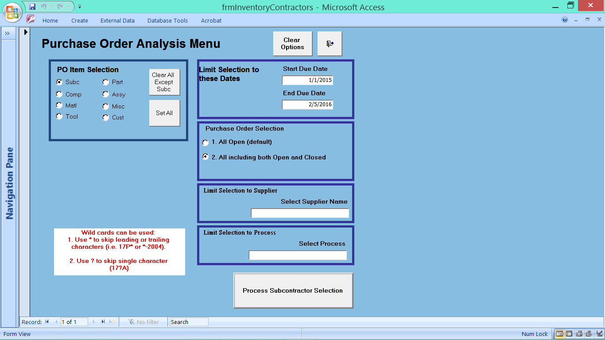
Tab to access PO’s for a defined timeline report based on matl., components, sub contracts, testing

Slide 40
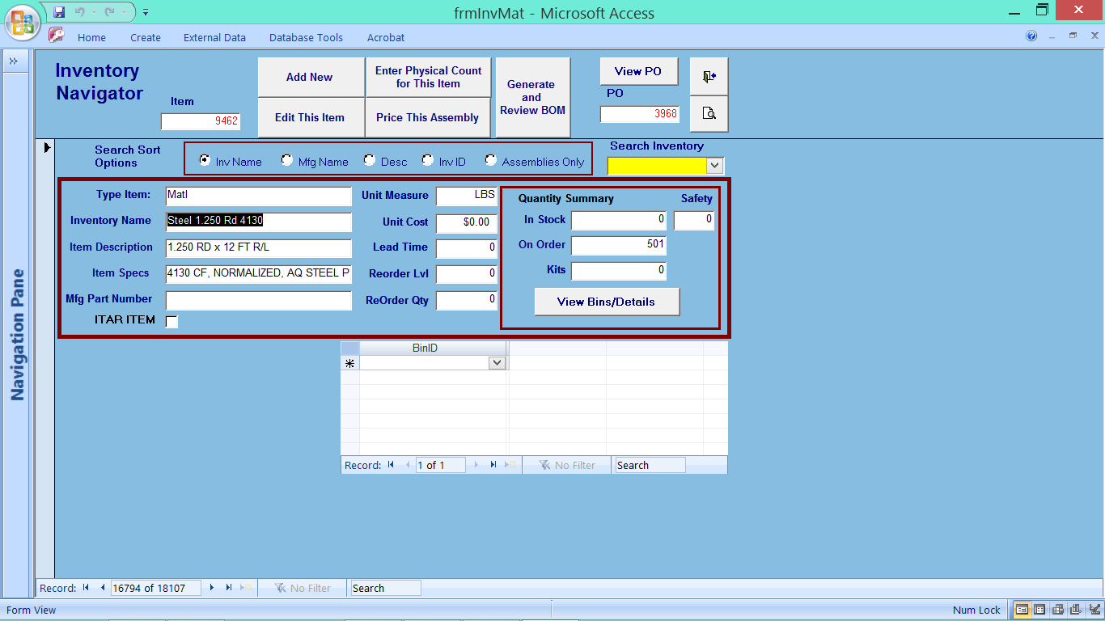
Form to access inventory items and track to past PO’s and history of parts

Slide 41
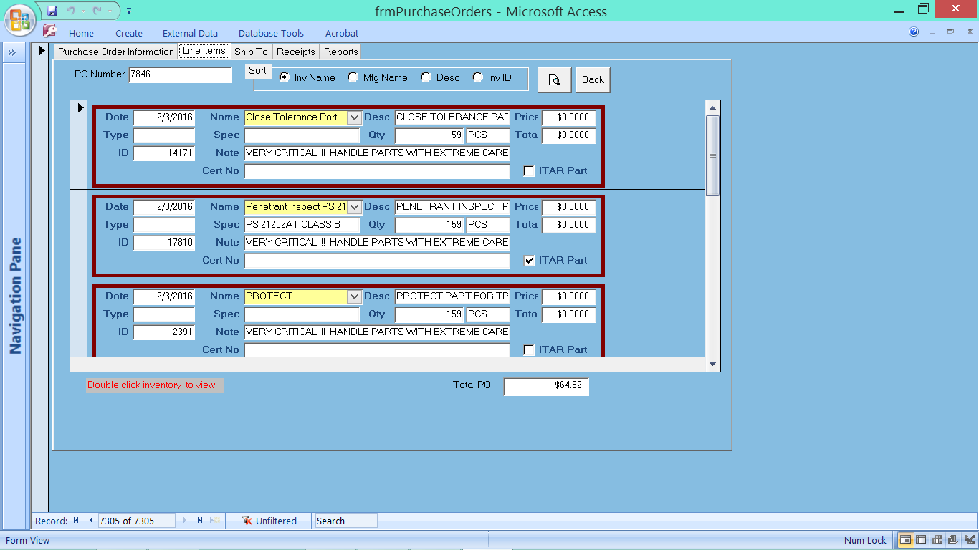
Line item procurement form, per ea. Per lb, per lot

Slide 42
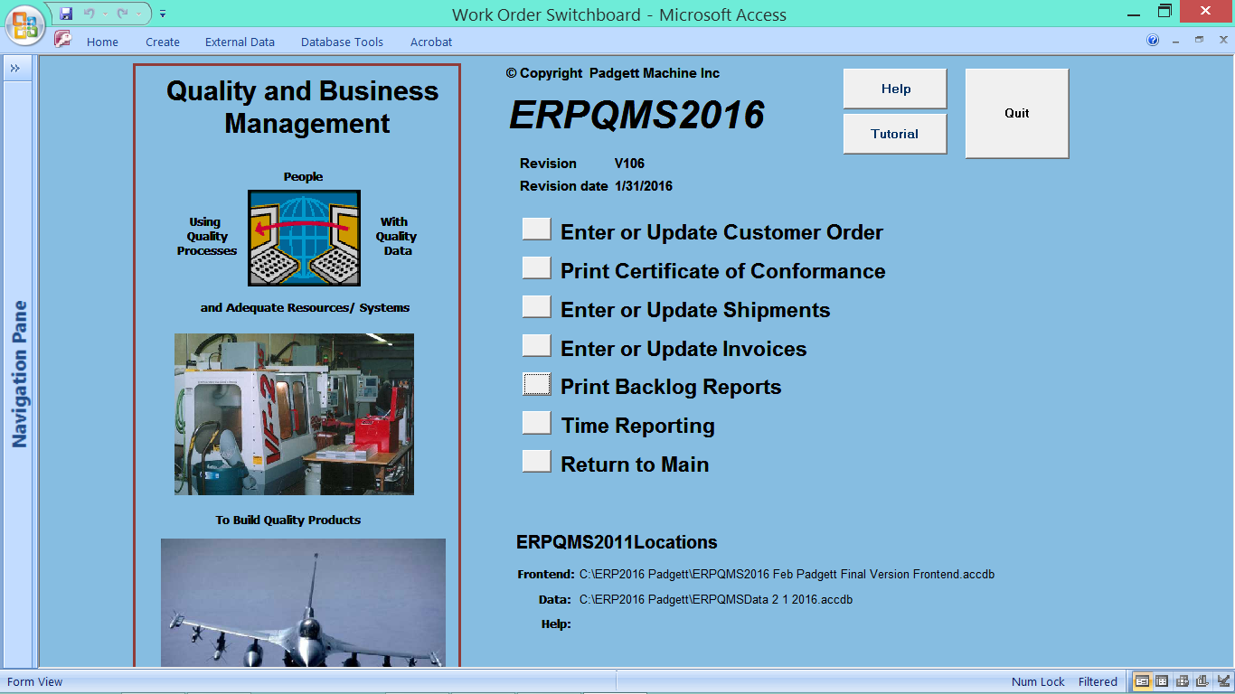
Customer Order Entry TAB, develop Certificate of Conformance, enter shipment data, order backlog, time reporting for specific work orders

Slide 43
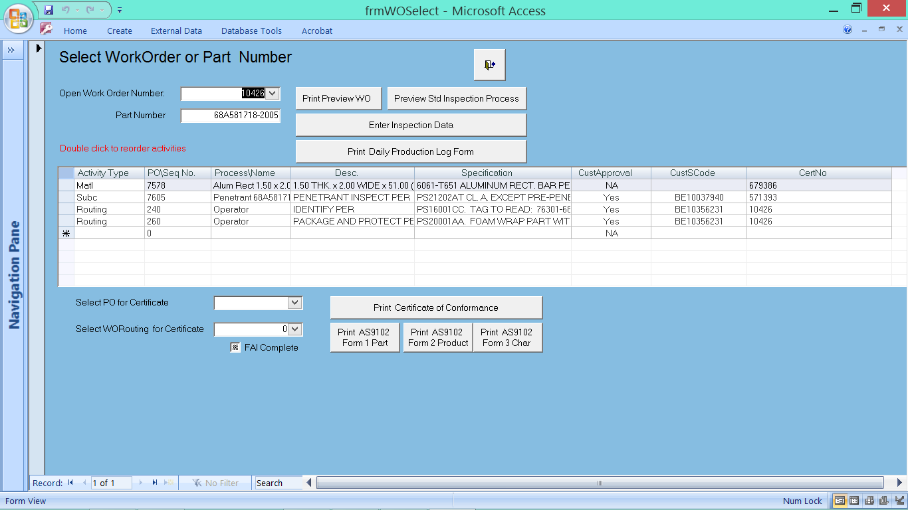
Form to develop Certificate of Conformance that accesses work orders and PO’s related to the part from drop down field. DDClick the PO and hyper link to PO issued. Loads vender data and certifications from venders to meet AS9102 FAI

Slide 44
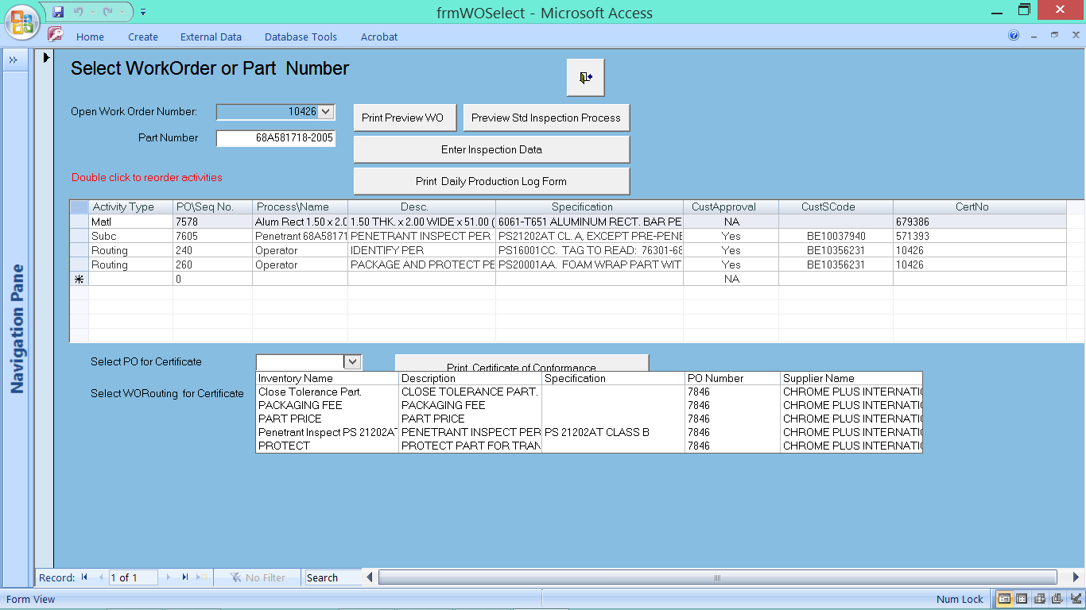
Drop Down Box to access PO for process or matl certification

Slide 45
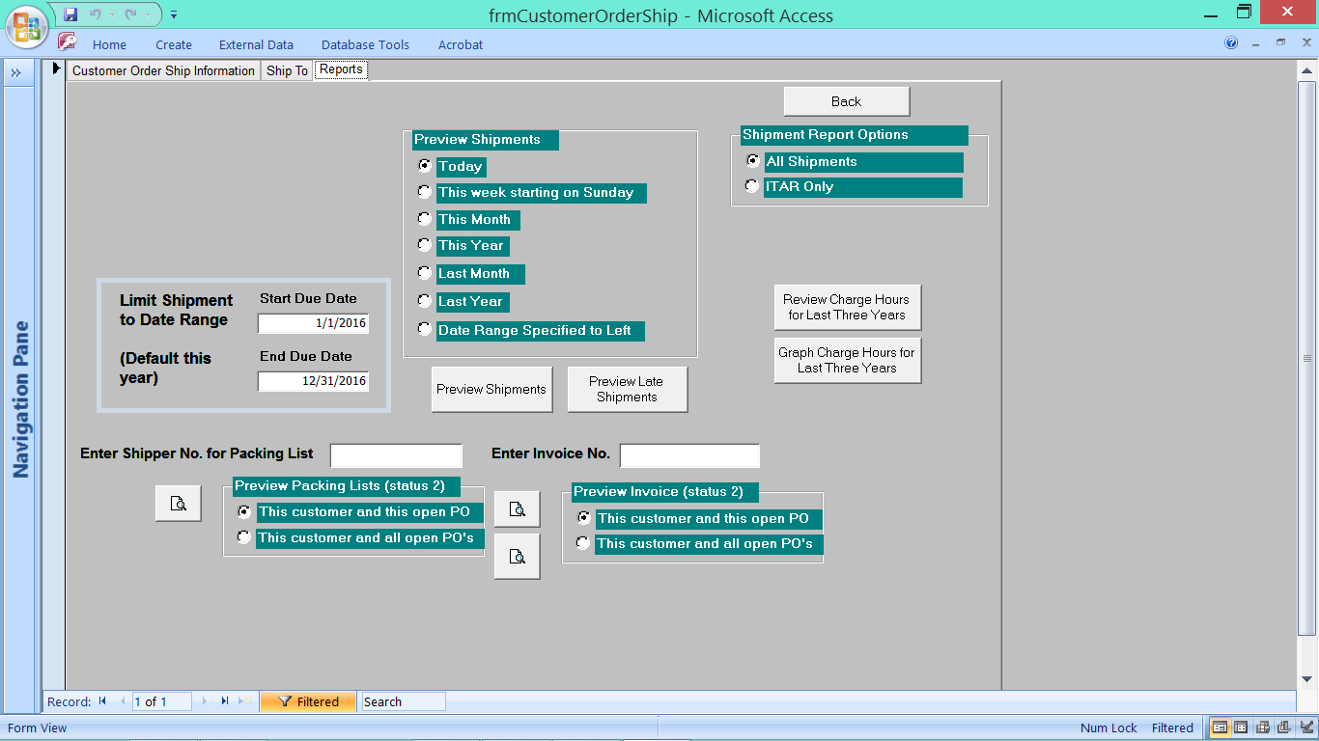
Track and develop reports for any timeline for any customer, track sales, by customer and dates, and evaluate shipments delivered to PO dates with ontime data reports

Slide 46
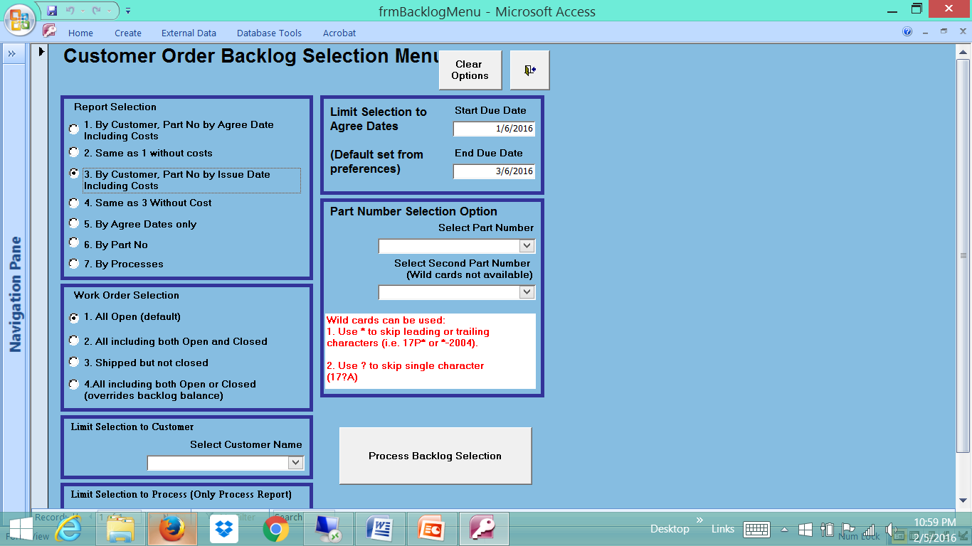
Form to access Customer PO data, by timeline, with and without costs, individual customer, or all customers showing due dates, order dates, agreed dates

Slide 47
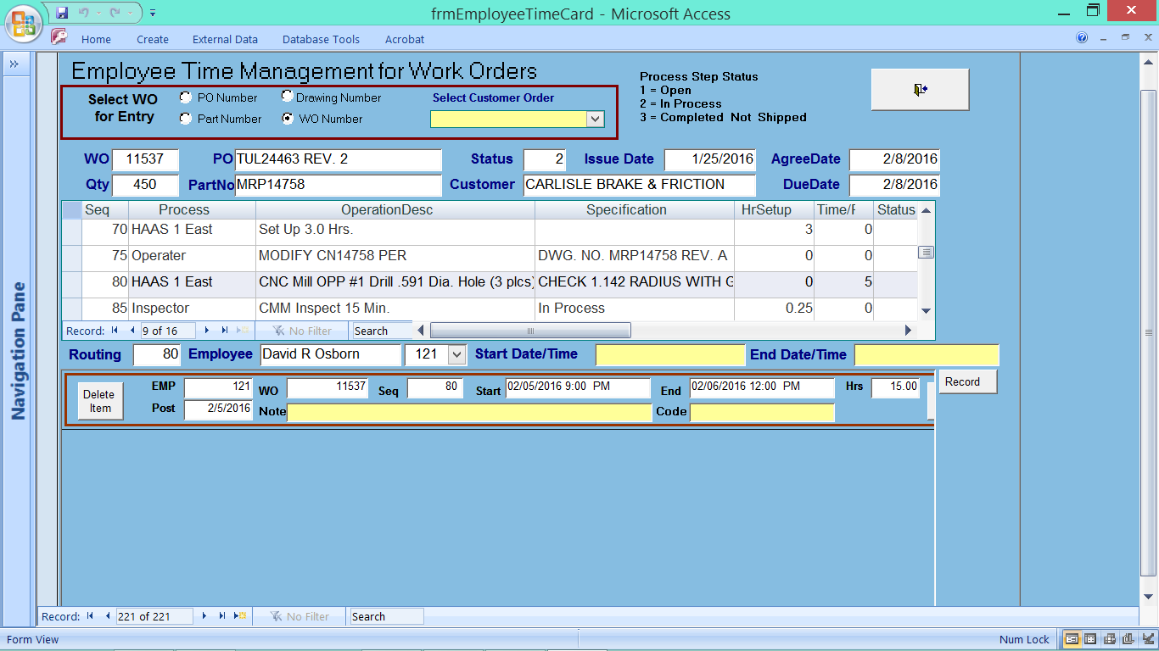
Time reporting by workorder with printable report by any timeline for any employee

Slide 48
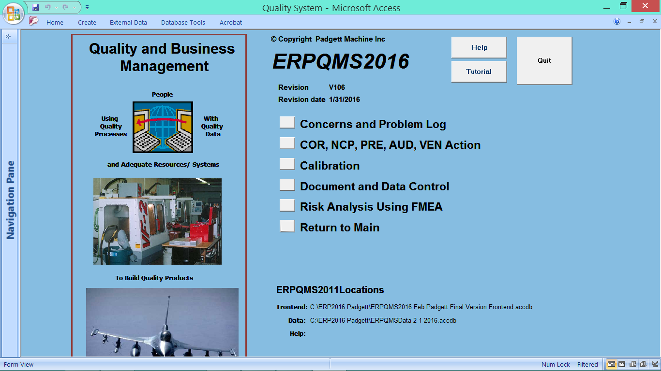
Quality Tab for Corrective, Non Conforming, Audit, Vender certification, Preventative Actions

Slide 49
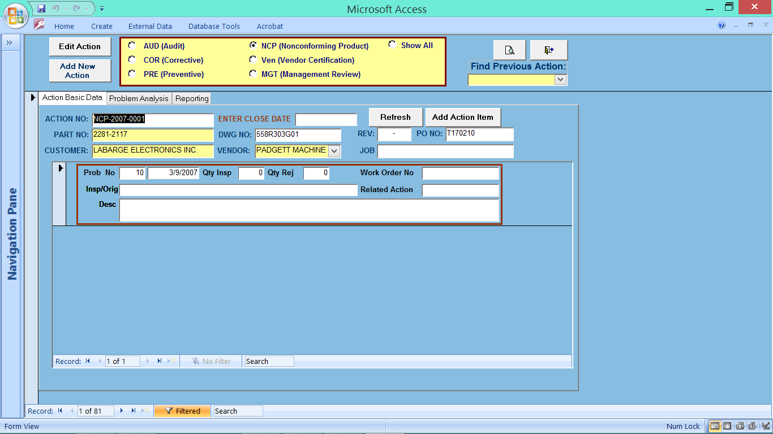
Form to access each Quality Module, Corrective, Non Conforming, Audit, Preventive, Management

Slide 50
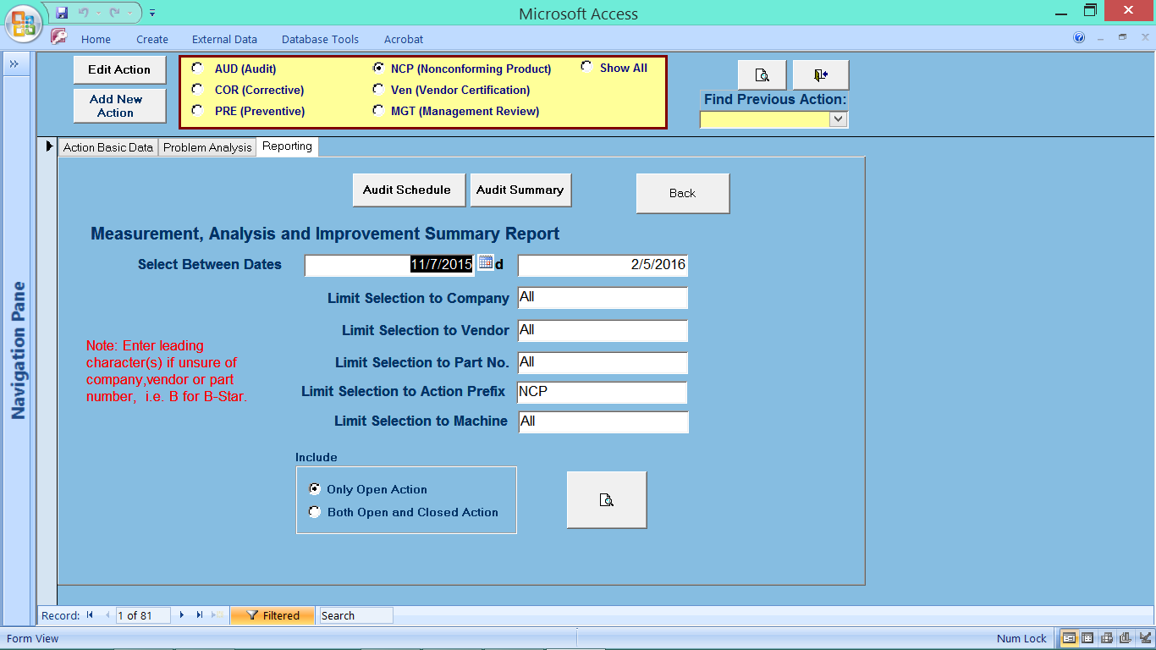
Reporting Module, closed or open, timeline for Corrective, Audits, Non Conforming, MGT, Preventative and Vender Certification process

Slide 51
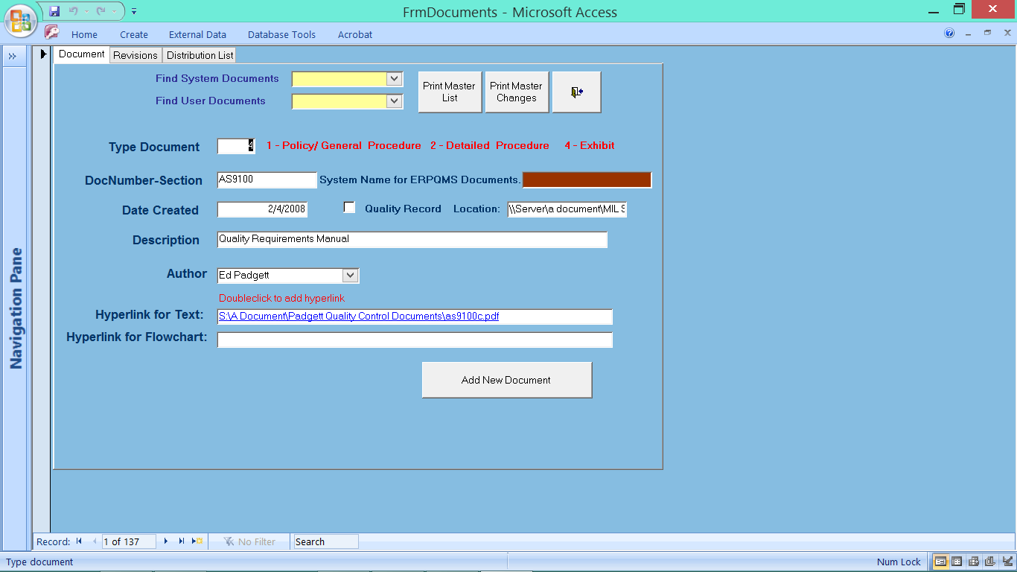
Form Controls and Reports all type of documents in your Company

Slide 52
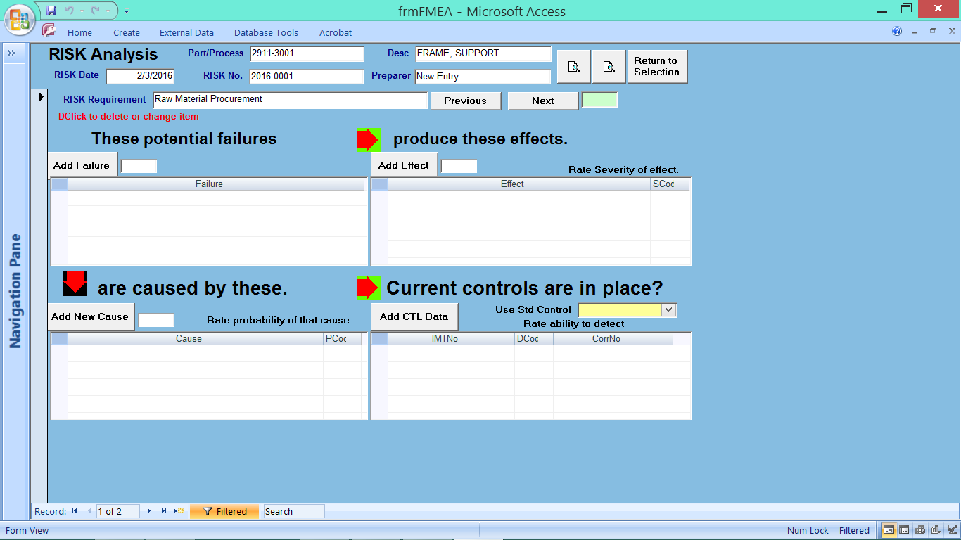
System to run Risk Analysis on process or part with reporting

Slide 53
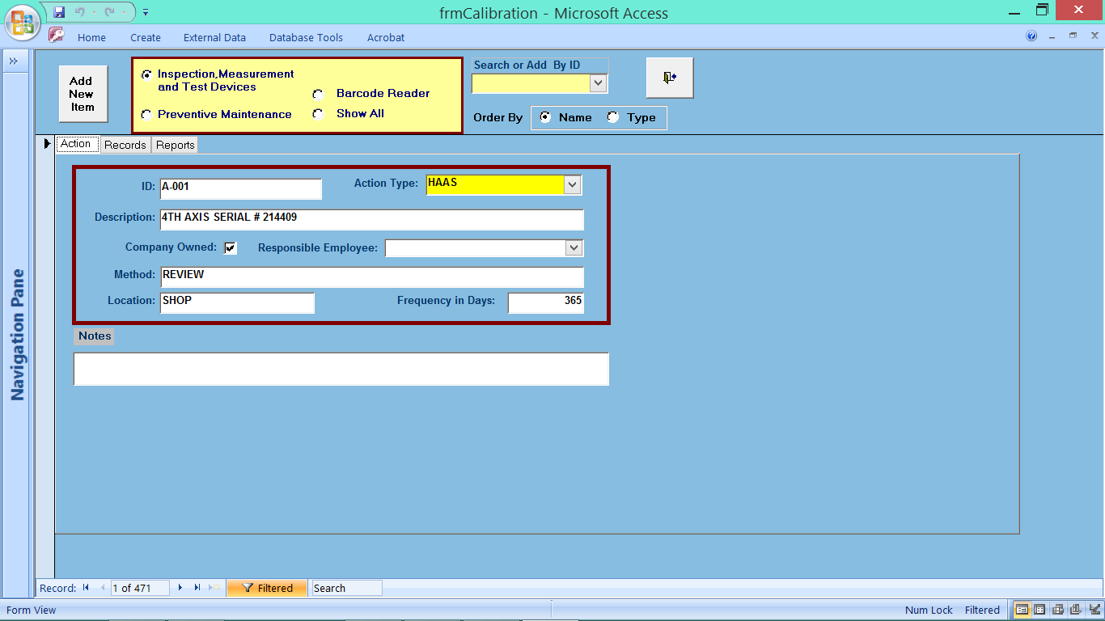
Module to define, monitor, and track the calibration of all inspection equipment with due dates. Including tracking of equipment

Slide 54
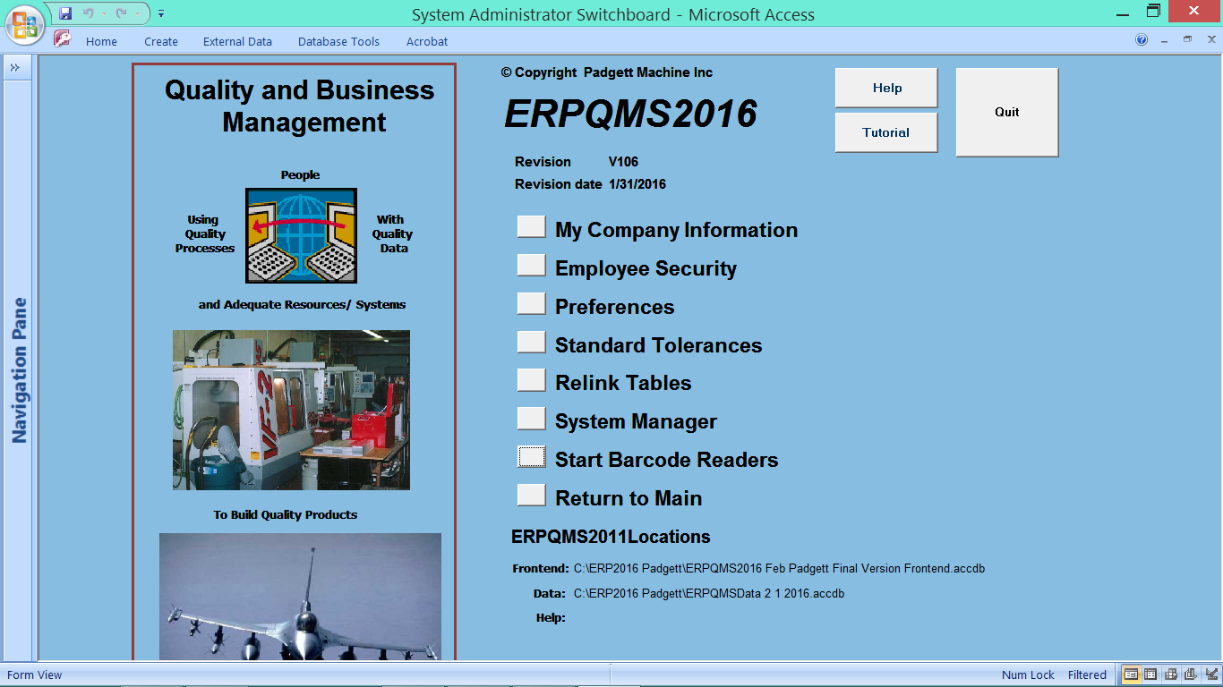
System Manager for Company Data load, employees, mfg preferences, updating software

Slide 55
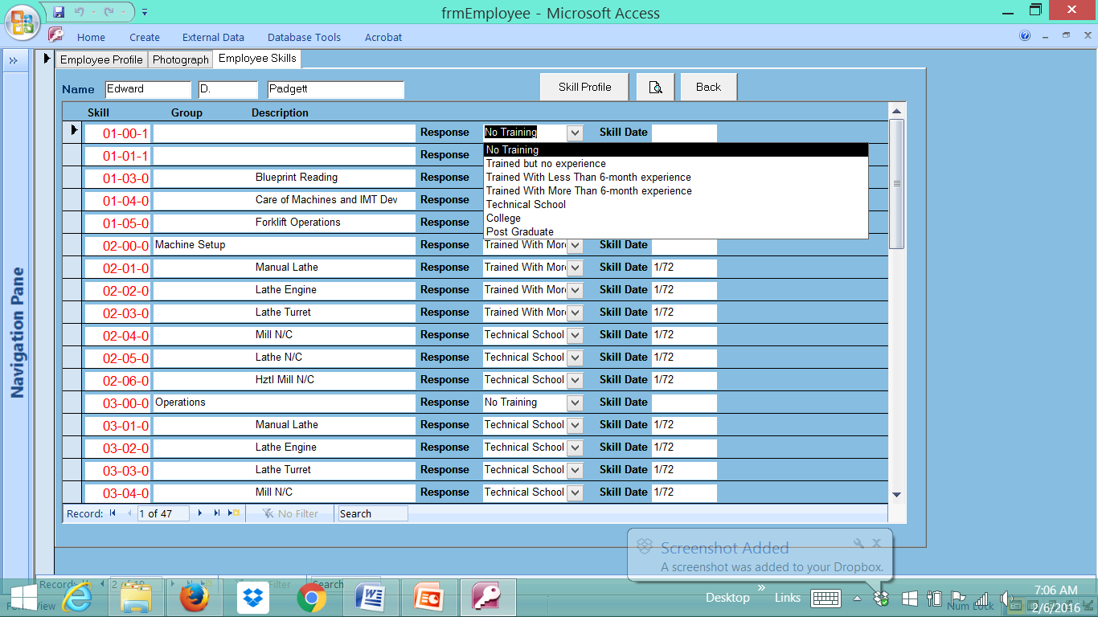
Training Form TAB for Employees Documentation with drop down field to define training levels

