Slide 1

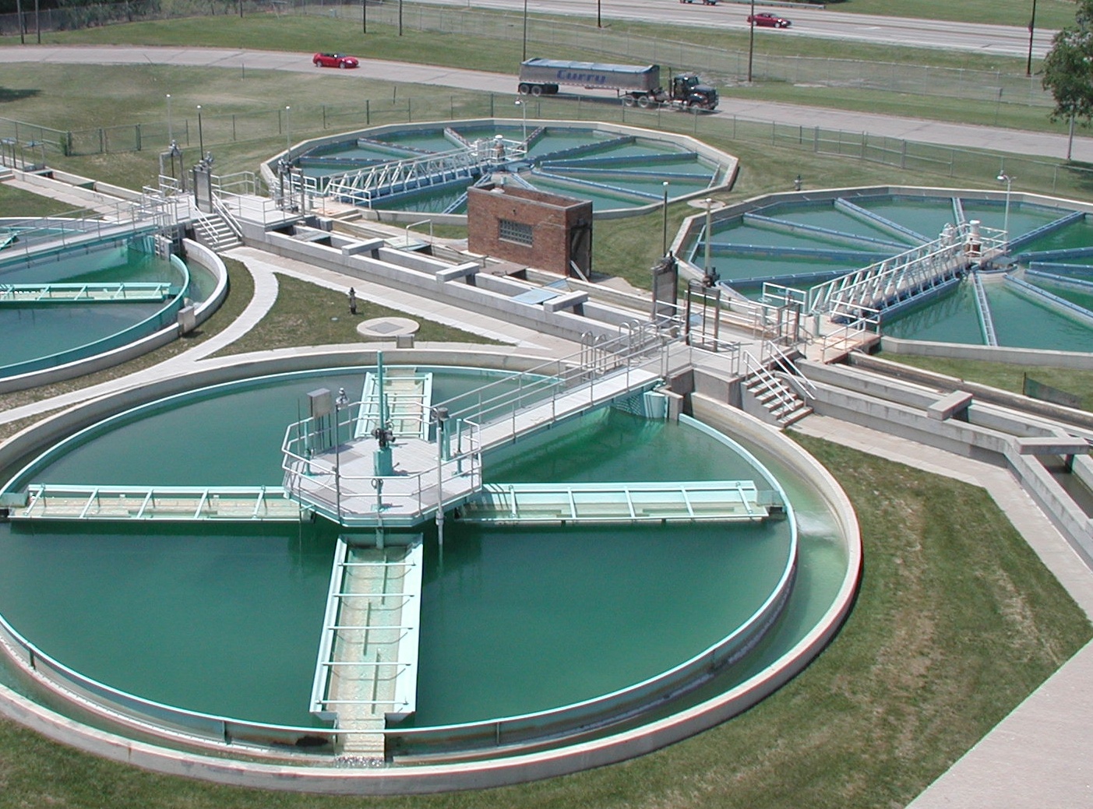
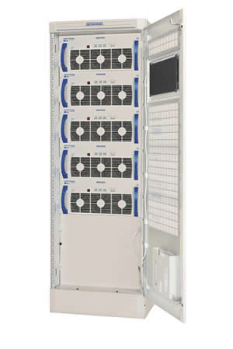
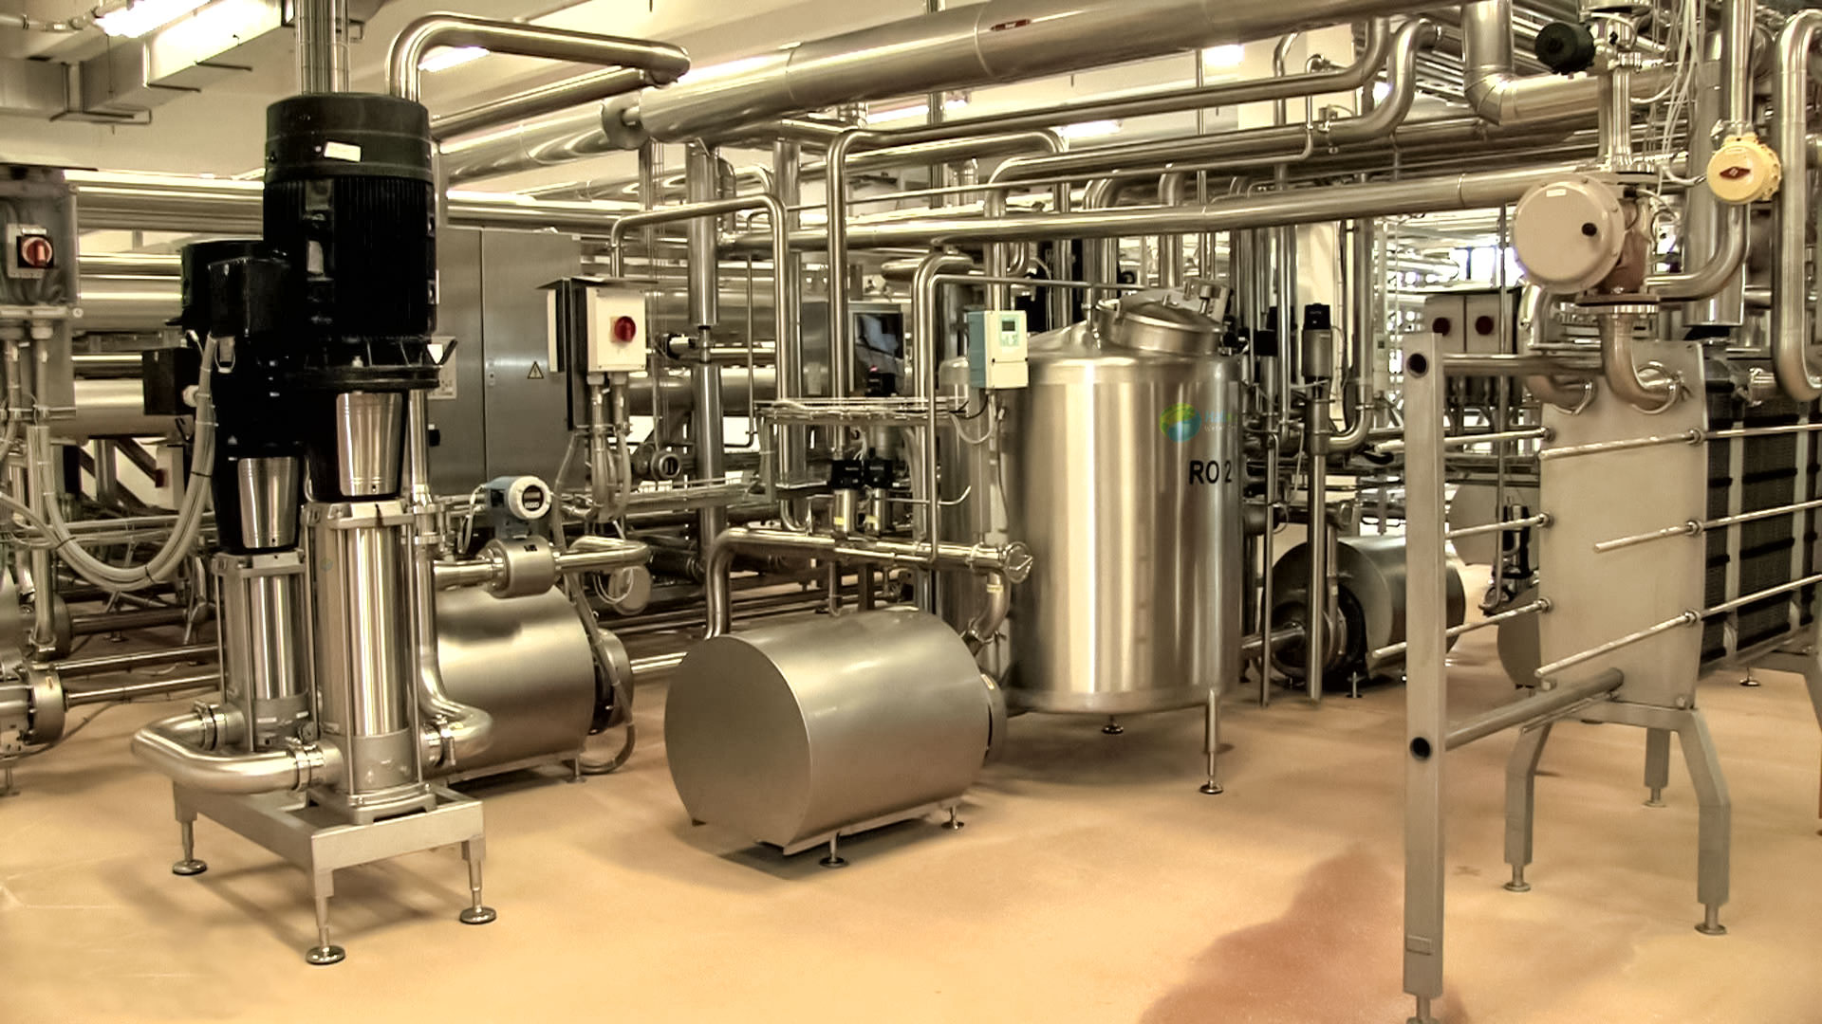
Industrial UPS in Water Treatment
Notes:
Rippling Water
(Basic)
Note: This video template is optimized for Microsoft PowerPoint 2010.
In PowerPoint 2007, video elements will play, but any content overlapping the video bars will be covered by the video when in slideshow mode.
In PowerPoint 2003, video will not play, but the poster frame of the videos will remain in place as static images.
The video:
Plays automatically after each slide transition.
Is 15 seconds long.
Seamlessly loops for infinite playback.
To add slides or change layout:
To add a new slide, on the Home tab, in the Slides group, click the arrow under New Slide, then click under Motion Background Theme, then select the desired layout.
To change the layout of an existing slide, on the Home tab, in the Slides group, click Layout, then select the desired layout.
Other animated elements:
Any animated element you insert will begin after the slide transition and the background video has started.
Layouts with video effects:
The “(Green) Title and Content” and “(Purple) Title and Content” layouts are creating by using a color overlay on the video.
With the video selected, under Video Tools, on the Format tab, in the Adjust group, select Color and choose Teal, Accent Color 6 Light (third row, seventh option from left) or Periwinkle, Accent Color 5 Light (third row, sixth option from left).

Slide 2
Modern Wastewater
treatment plants
Today’s plants are fully automated, relying on an advanced Supervisory Control and Data Acquisition or SCADA network to control treatment processes.
A SCADA network is a computer control system that uses Remote Terminal Units or RTUs to interact with objects in the physical world

Slide 3
Remote Terminal Units
(RTUs)
RTUs are microprocessor-controlled devices that interface the physical world to the SCADA system
RTUs are often power sensitive and needs a clean high quality power source that needs to be protected from short and long term outages.
Due to large pumps and motors, the utility Power supplied to the plant may be polluted with voltage sags and high-voltage transients

Slide 4
The Role of a UPS in a
WasteWater Treatment plant
The UPS provides clean reliable back up power in the event of utility loss
In addition to providing back up power, UPS are often installed to condition power to the microprocessor-controlled RTU and other power sensitive equipment in the facility
These UPS are usually installed outdoors and exposed to the elements

Slide 5
Critical Process
The SCADA system is integrated throughout the plant and serves two primary functions
Process monitoring
Process Control
Any failure in the network has the potential to shut down the entire process leading to potential………

Slide 6
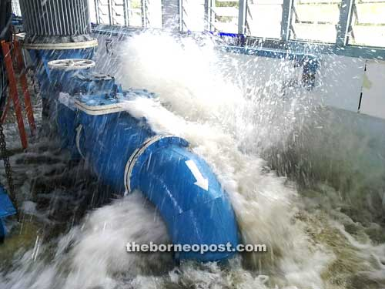
Down time and unplanned maintenance

Slide 7
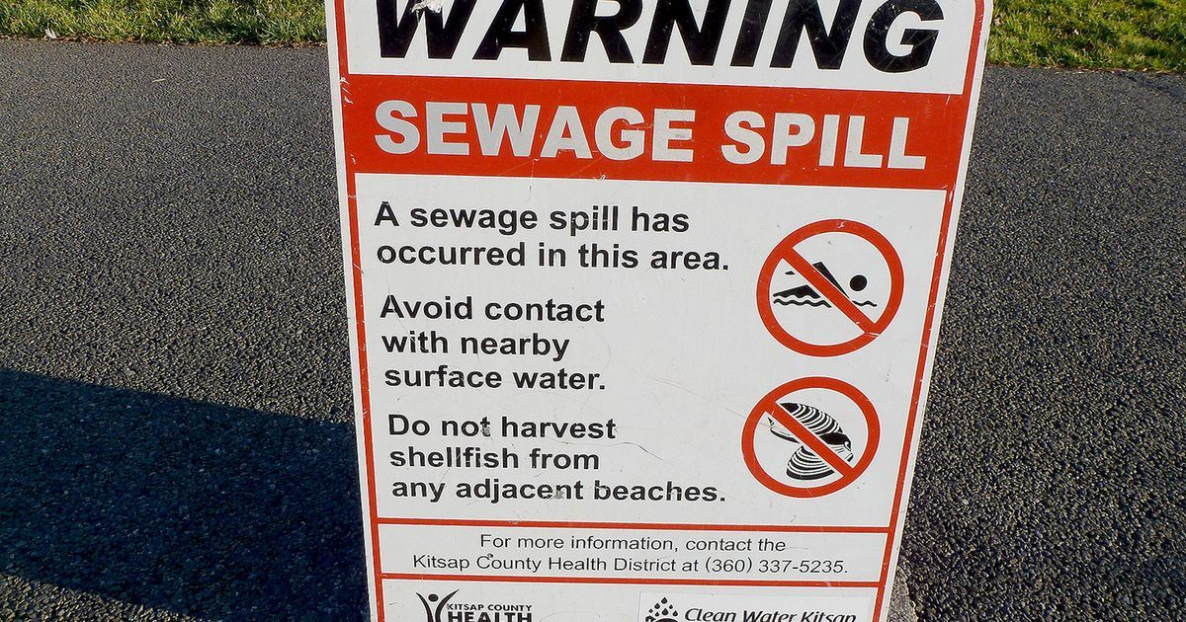
Health Hazards
Notes:
test

Slide 8

Environmental Hazards

Slide 9
Interior Environments
Electronics in a wastewater treatment plant face a myriad of unforgiving environmental conditions.
Such as
Temperatures above 40° Celsius
High condensing humidity
Exposure to corrosive gasses

Slide 10
Office Grade UPS
Commercial or “Office Grade” UPS are not designed for continuous operation in the high temperatures or harsh environments within water facilities.
Commercial UPS publish a 104F “operating temperature”, but this rating is meant for short periods of time such as during a power outage when HVAC is typically lost.
Lack of maintenance often contributes to higher rates of failure within water facilities.

Slide 11
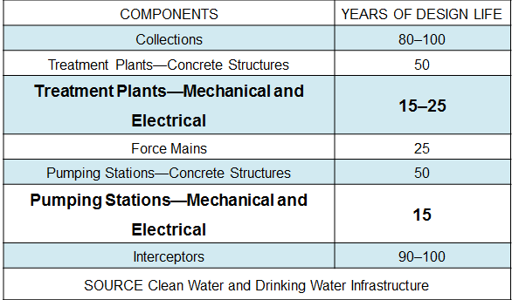
Notes:
In 2002 the EPA reported that the life expectancy of mechanical and electrical systems for facility components, like treatment plants and pumping stations, needs replacement every 15 – 25 years.
How can you increase the life of your electrical systems
by 2,3,5, or 10+ more years.
Stretching taxpayer dollars further.
11

Slide 12
The Industrial difference
  Industrial UPS, being designed for 20 years of Continuous Operation Are More Robust and Tolerant
  Wider Design Margins Reduce Internal Component Loading, which allows for higher operating temp
  Additional Filters Reduce DC Ripple, an IGBT rectifier in lieu of SCR virtually eliminates DC ripple while minimizing reflected harmonics (THD) to 3% - 5%
  Input and Output Iso Transformers “Galvanic Isolation”, provides a complete separation from the output to input
  Conformal Coating of Circuit Boards is possibly the single most important spec requirement & least expensive
  A Rectifier/Charger Section Can be Upsized for Longer Run Times and Increased DC Availability

Slide 13
Industrial UPS Serviceability
Industrial UPS manufacturers anticipate the owner maintaining & servicing their own equipment.
Replacement components are available for a minimum of 20 yrs vs. 10 yrs availability with commercial UPS.
If specified, industrial UPS manufacturers will provide service manuals with their O&M.
The DC bus voltage should be specified to be as low as possible for safety in servicing, reduced battery footprint & cost of batteries. (125vdc)
The UPS manufacturer shall have factory trained service technicians within 50 miles of the installation site.

Slide 14
Recommended Specification Points
20 Year design life for light industrial, 30 year design life for heavy industrial and 40 years for nuclear (4E).
250,000/Hr. MTBF without going to bypass is a typical industrial UPS rating.
No single component shall be loaded to more than 60% of it’s nameplate rating.
Redundant internal components including SCRs, caps, power supplies & fans.
If specified correctly a 20 year installation for both the UPS & the battery is very reasonable. Especially when the UPS is paired with a NiCad battery system.
The UPS shall be rated to operate at 50 degrees C continuously without derating.

Slide 15
Choosing the correct UPS
Only true online double conversion Industrial UPS can reliably operate in the unforgiving environment of a wastewater treatment plant while providing a constant, clean and conditioned AC power source to SCADA and other critical electronics

Slide 16
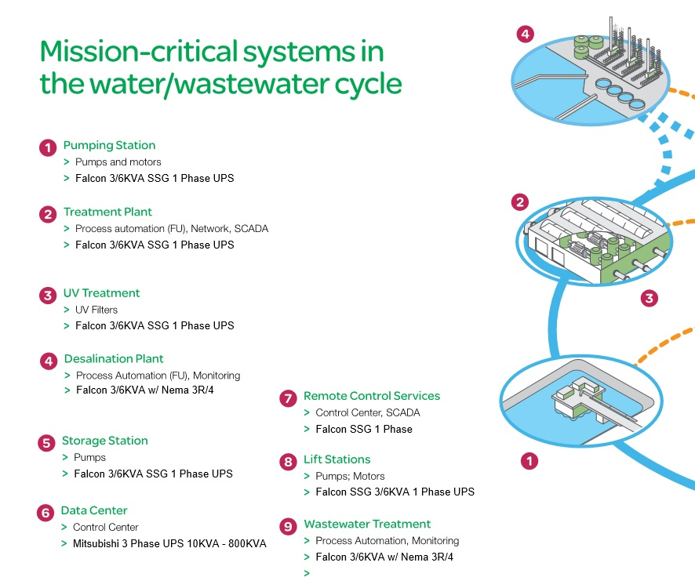
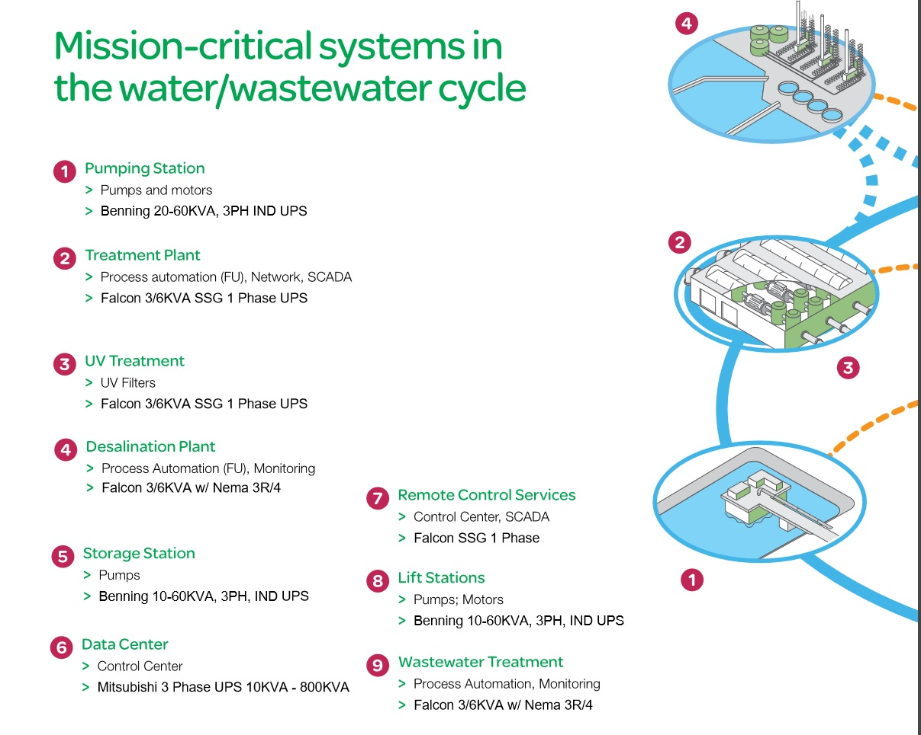

Slide 17

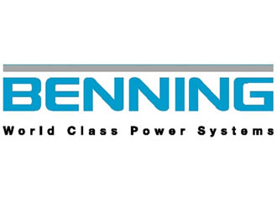

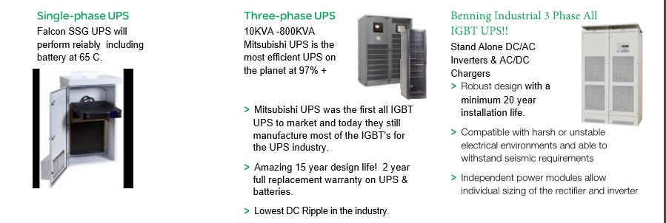
MEET THE TEAM!!

Slide 18
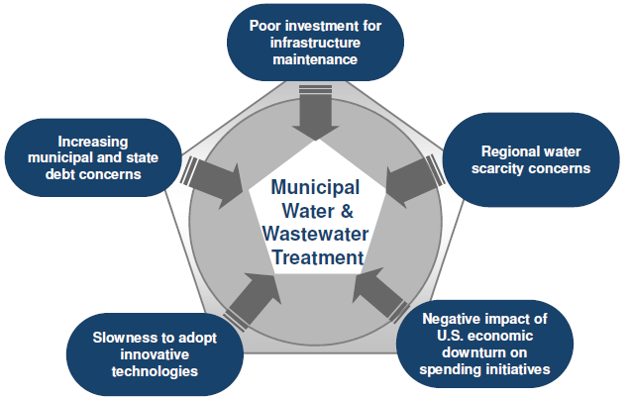
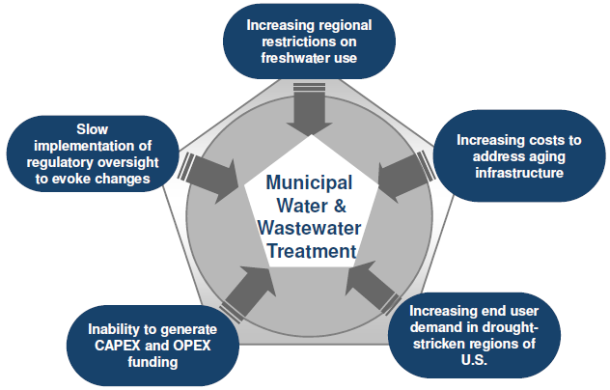
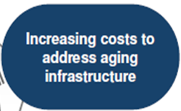
Industry Challenges
2012
Top Five Industry Challenges (U.S.)
2013-2018
Top Five Industry Challenges (U.S.)
Notes:
When Frost & Sullivan reported and compared the top 5 concerns from 2012 and compared them to 2013 and beyond, the words changed but most of the core messages didn’t.
For 2012 for 2013
Poor Investment, costs and aging infrastructure
Scarce Water, drought-stricken regions
negative economy, poor funding
slow adoption of technologies, slow to change
increased government debt. Restrict freshwater use
18

Slide 19

2008 National Electric Code
NEC Section 708.20 (D)
Surge Protective Devices must be used to comply
SPDs must be used for each voltage at the facility
  Service Entrance
  Distribution panels
Notes:
As can be seen in section 708.20 (D) the proper application of surge protection devices is one way of ensuring enhanced reliability and protection for the electrical infrastructure for water and waste water applications.
Protecting the initial investment and extending the useful life of critical loads.

Slide 20


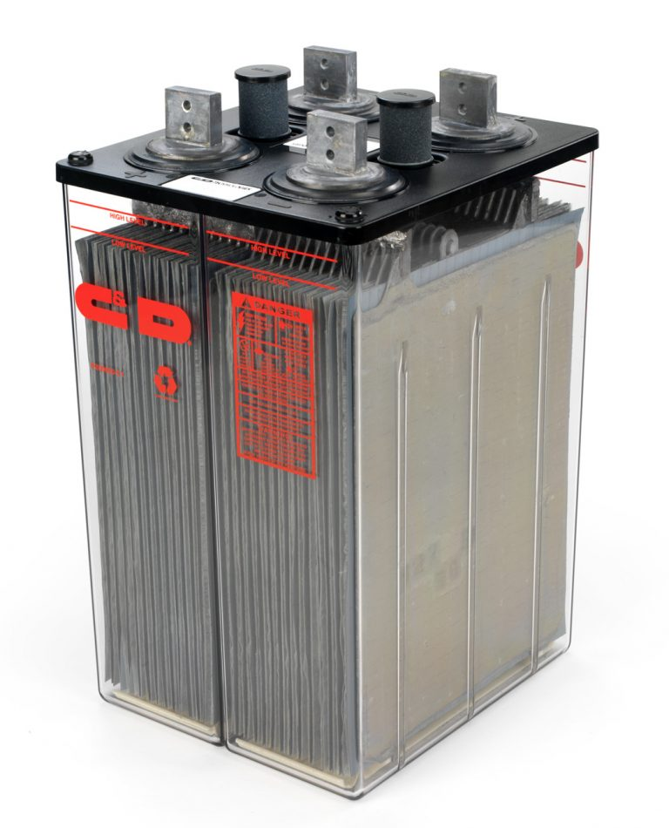
Battery Topologies
Types of Batteries….
10 Year Valve Regulated Lead Acid (VRLA)
20 Year Valve Regulated Lead Acid (VRLA)
20 Year Wet Cell – aka Flooded Cells
25-35 Year Life Cycle Sodium Nickel
25 Year Life Cycle by HBL NiCad

Slide 21
20 Year VRLA Batteries
20 Year Sealed, Front Bus Bar Connections
Last Closer to Rating Typically 12-15 Years
Stackable Modules for Smallest Footprint
Flexible Configurations WxDxH are adjustable

Slide 22
Batteries – 20 Year Flooded
( Wet Cells)
20+ Year Life Expectancy If Maintained Properly
Mounted on Open Air Racks, Hydrogen Venting
Require Eye Wash, Spill Containment, Ventilation
Quarterly Maintenance Required & Documented

Slide 23
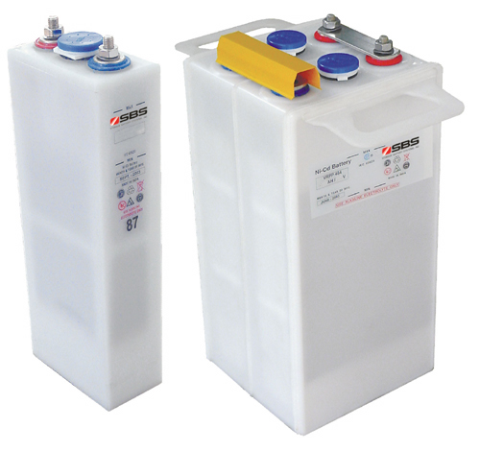

NiCad Batteries
25-30 Year Life Expectancy
Harsh Environments OK
No Temperature Control
Short Cycling Capable
Open Air Rack Mounting
2-3X Times the Cost of a 10 Year VRLA Battery

