Slide 1



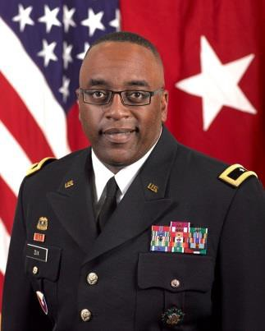
GROOMING LEADERSHIP FOR AMERICA’S FINEST OFFICERS
Premier
Grooming Leadership and Strengthening Our Profession of Arms
“The Professional Book”
What does it do?
Stewards the Army Profession
Enhances Professional Development
Enhances Character, Competence and Commitment
BG Rich Dix
Commanding General of the Joint Munitions and Lethality Life Cycle Management Command and Joint Munitions Command
Premier
COMPETENCE
CHARACTER
COMMITMENT

Slide 2
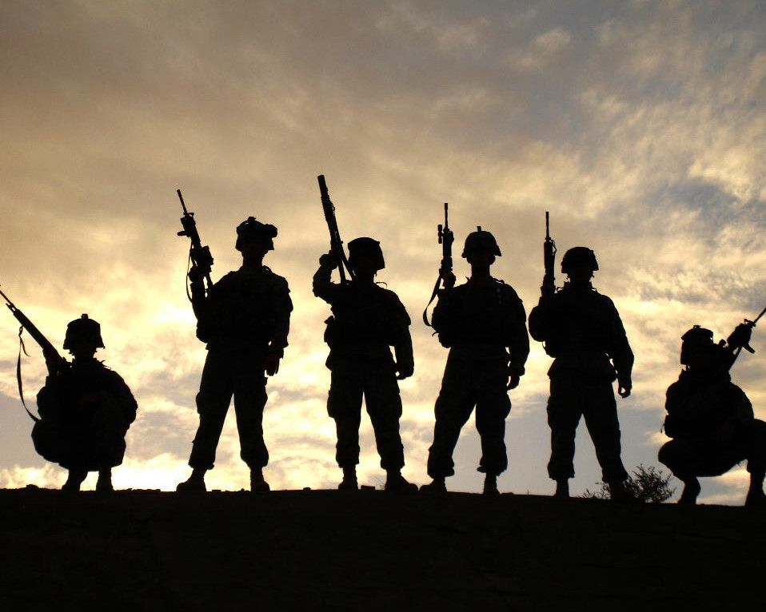







THE PROFESSIONAL BOOK
COVER PAGE
MAJ JOHN DOE
Premier
LOYALTY
DUTY
RESPECT
SELFLESS SERVICE
HONOR
INTEGRITY
PERSONAL COURAGE

Slide 3


Table Of Contents
TAB A
Biography
TAB B
ORB
Shows Organizational Skills
TAB C
Resume
Shows Management Skills
TAB D
OER Strength Chart
Shows Professionalism
Manages Career (AR 600-3)
TAB E
OERs
Manages Family Goals
TAB F
Career Plan

Slide 4



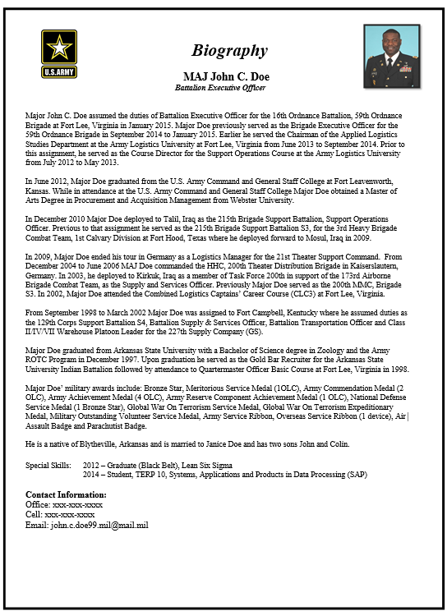


Biography
TAB A
TAB A
DA PHOTO
Biography
(Information Lead-in)
Background
Previous Jobs
Family
Special Skills
Contact Information

Slide 5

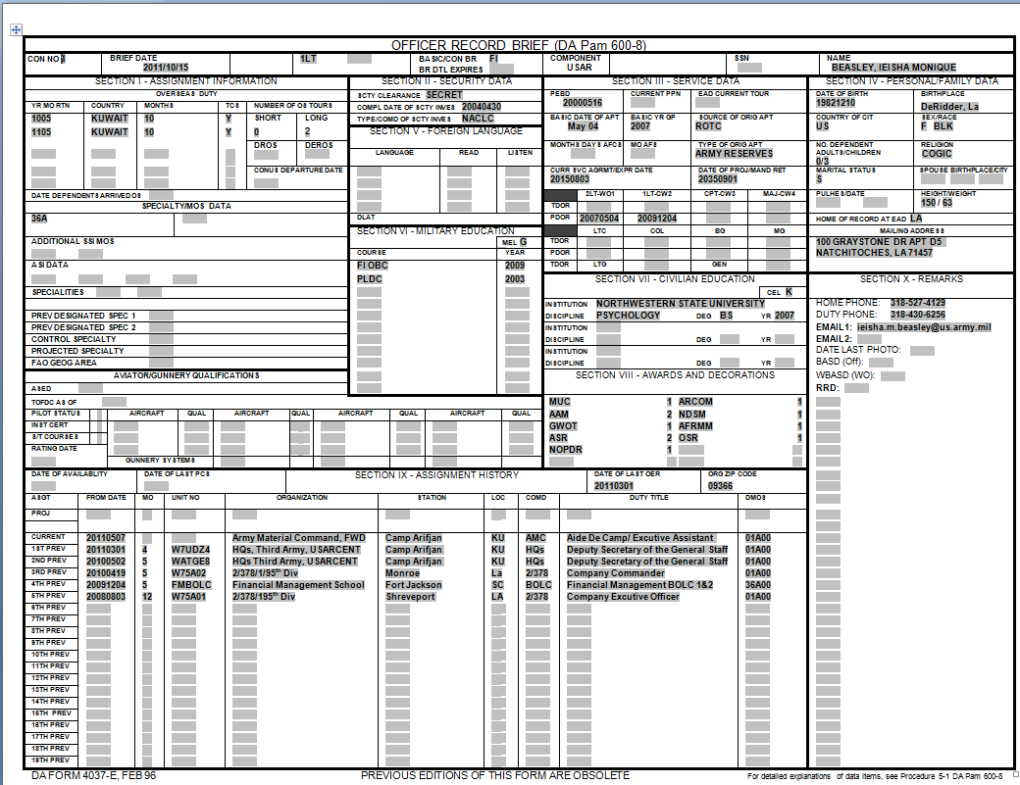

Officer Record Brief
TAB B
Security Clearance
Marital
Status
Overseas
Duty
Mailing Address
Home & Duty Phone Numbers
Military Education
Duty Title
S-1 can assist with updating your ORB
Overseas Duty
Security Clearance
Marital Status
Mailing Address
Home & Duty Phone Numbers
Duty Title
PULHES
Military Education
Tracks deployment experience
Affects job availability
Needs to be current (MARRIED, SINGLE)
Must be current so HRC can contact you for potential assignments
Must be current so HRC can contact you for potential assignments
OER Duty title must be consistent - Must be translatable to the Board
Demonstrates Individual Readiness; can affect assignments
Continuous Learning/Professional Development

Slide 6


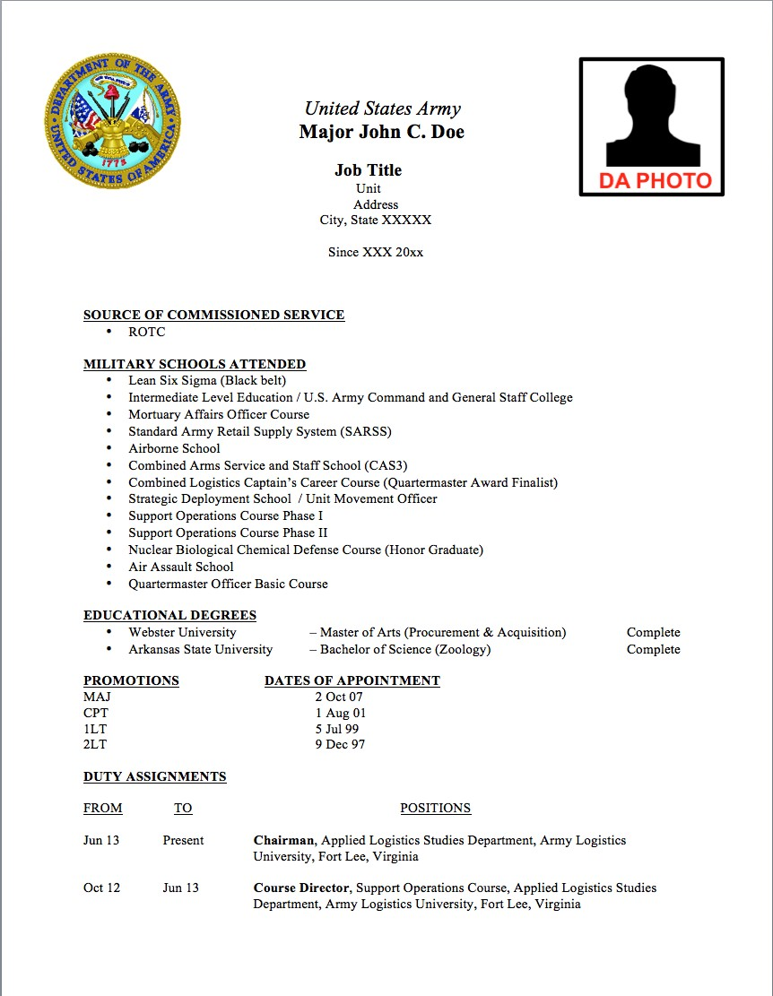
Military Resume
TAB C

Slide 7
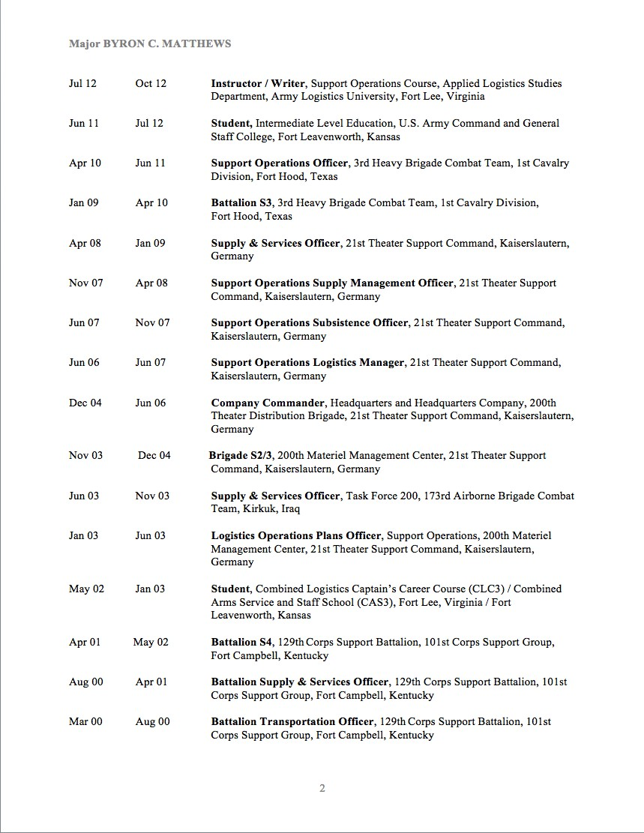

Military Resume
TAB C
Your Name

Slide 8
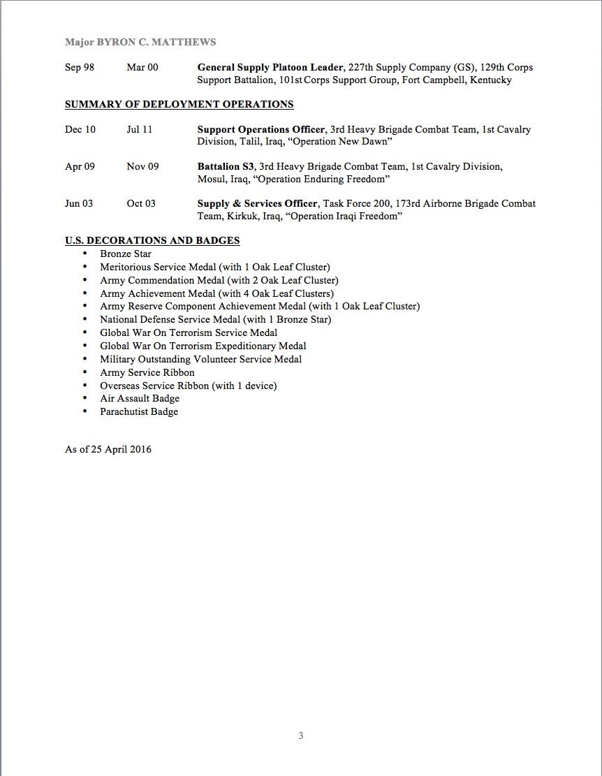
Military Resume
TAB C
Your Name

Slide 9


OER Strength Chart
TAB D
PURPOSE : TO ASSIST EACH OFFICER IN MANAGING THEIR CAREER
SO WHAT:
  ALLOWS AN IN-PROGESS ASSESSMENT OF YOUR FILE (MENTEE/MENTOR)
  FACILITATES CAREER COURSE OF ACTION ADJUSTMENT
  DESIGNED TO KEEP YOU ON TRACK TO REMAIN COMPETITIVE
To move green lines
  - Right click “edit points” and then drag and drop to new location
Chart graphically depicts your report file strength (Senior Rater Comments):
  Each report should address the five considerations at bottom of chart
  5 of 5 is the most desirable and strongest report
  1 of 5 indicates a weak report with weak write up

Slide 10


Strategic Leader OER Strength Chart
TAB D
XO to Deputy COS Army G4
Director for Strategy and Integration
Quantification from Last Five OERs
BDE CDR
Rater
“Best Officer I rate” (1 out of 4)
Position Held
ENUMERATION
S. Rater
“Best COL in my Division, hands down.” (out of 32)
Rater
“Top 5% of Officers whom I have served.” (out of 33 yrs)
For each Senior Rater comment that fulfills criteria add one point.
S. Rater
“3 of 19 COLs I senior rate”
Rank
COL
COL (P)
COL (P)
Rater
“Top 5% of officers I have served with” (out of 33 yrs)
5
S. Rater
“Top 3 of 26 COLs who have served in the Division”
Multi-Star Potential (limited to 24%)
4
3
(Criteria is met by having a statement that covers each of the five areas listed)
2
1
5
Promote to BG (limited to 26-49%)
4
Rater
“Best BDE CDR in the Division (1 out of 5)”
3
S. Rater
“Top BDE CDR (1 out of 10)”
2
1
COMMAND
Rater
“Place in command of the most challenging ESC deployed under arduous conditions.”
5
Retain as Colonel
4
S. Rater
“Consider strongly for an ESC command”
3
“Select for the most challenging command”
2
Rater
1
S. Rater
“Position for a one star command”
Not Qualified
Quantification from Last Five OERs
Rater
N/A
Rater
N/A
S. Rater
Send to Executive Broadening
“potential is truly unlimited to
SCHOOLS
Assignment now
POTENTIAL
S. Rater
command!”
Rater
N/A
Rater
N/A
S. Rater
“Demonstrates multi-star qualities”
S. Rater
Send to Harvard Broadening Assignment now
Rater
N/A
PROMOTION
Rater
“Promote Rich to BG immediately”
S. Rater
“potential is limitless”
S. Rater
“Operates at the multi-star level now; promote ASAP”
Rater
N/A
Rater
N/A
Rater
“Promote to BG now”
S. Rater
“Expedite to Enterprise
Assignment immediately”
S. Rater
“Superb potential”
S. Rater
“Promote him immediately, multi-star potential”

Slide 11


Field Grade OER Strength Chart
TAB D
Quantification from Last Five OERs
Position Held
Fellowship
RPOE CDR
BDE S4
BN SPO
BN SPO
BDE S3
BN CDR
Rater
“Best Officer I rate” (1 out of 4)
ILE
BN XO
BN XO
S. Rater
N/A
ENUMERATION
Rater
“Top 25% of Officers whom I have served.” (out of 23 yrs)
S. Rater
“Top 4 of 19 MAJs I senior rate”
For each Senior Rater comment that fulfills criteria add one point.
Rank
MAJ MAJ MAJ MAJ MAJ MAJ MAJ MAJ (P) LTC
LTC
Rater
“Top 5% of officers I have served with” (out of 23 yrs)
Most Qualified (limited to 49%)
5
S. Rater
“Top 3 of 26 Major’s who have served in the Task Force”
4
Rater
“Top 1% of LTC’s I have served with” (out of 25 yrs)
3
S. Rater
“Top 1% of LTC’s I have rated in my 27 year career”
2
“Selected as the number one Commander out of 5…”
(Criteria is met by having a statement that covers each of the five areas listed)
1
Rater
5
S. Rater
“Selected as the number one Commander out of 20…”
Highly Qualified
4
Rater
“Assign as a CDR for a deploying Transportation Battalion”
3
“Select him for the toughest Battalion Command”
2
S. Rater
1
Rater
“Place in command of the most tactically challenging
battalion deployed under arduous conditions.”
5
COMMAND
4
S. Rater
“Consider strongly for early battalion command”
Qualified 3
2
Rater
“Select for the most challenging command”
1
S. Rater
“Position for a challenging battalion command”
Not Qualified
Rater
“send immediately to command a deploying battalion”
Quantification from Last Five OERs
S. Rater
“send Rich to lead the toughest deploying battalion”
Rater
“send to ”
Rater
“Unlimited Potential!”
Rater
“Place him in charge of an SDDC Brigade”
S. Rater
N/A
N/A
S. Rater
“Place him in charge of a Sustainment Brigade”
Rater
“send him to ”
S. Rater
Rater
N/A
SCHOOLS
“send to the ”
POTENTIAL
Rater
“Boundless potential”
S. Rater
“Demonstrates BZ qualities; Promote to LTC”
S. Rater
S. Rater
“Potential is unlimited”
PROMOTION
Rater
“Promote to LTC immediately”
Rater
“[send] to ”
Rater
“Inexhaustible potential”
S. Rater
“Operates at the LTC level now; promote ASAP”
N/A
“Superb potential”
Rater
“Promote to LTC now”
S. Rater
S. Rater
S. Rater
“Promote him immediately”
Rater
“send to resident CGSC/ILE”
Rater
“Immeasurable potential”
Rater
“Promote below the zone to COL”
S. Rater
“send him to resident now”
S. Rater
“Groom for the toughest leadership positions; he is a future superstar”
“Promote to COL now, below the zone”
S. Rater
Rater
“send to ILE ahead of peers”
Rater
“Brilliant officer and leader…”
Rater
N/A
S. Rater
“send to ILE immediately”
S. Rater
“Unlimited potential…”
S. Rater
N/A

Slide 12


Company Grade OER Strength Chart
TAB D
Platoon Leader
Executive Officer
Quantification from Last Five OERs
Battle Captain
Aide-de-Camp
CLC 3 Student
Asst. BDE S4
Company CDR
Company CDR
Fellowship
Rater
“Best Officer I rate” (out of 4)
Position Held
ENUMERATION
S. Rater
“Best CPT in my BN, hands down.” (out of 12)
Rater
“Top 25% of Officers whom I have served.” (out of 23 yrs)
S. Rater
“Top 4 of 19 CPTs I senior rate”
For each Senior Rater comment that fulfills criteria add one point.
Rater
“Top 5% of officers I have served with” (out of 23 yrs)
Rank
2LT
2LT
1LT
1LT(P)
CPT
CPT
CPT
CPT
CPT(P)
S. Rater
“Top 3 of 26 CPTs who have served in the Task Force”
Most Qualified (limited to 49%)
5
Rater
“Top 1% of CPTs I have served with” (out of 25 yrs)
4
S. Rater
“Top 1% of CPTs I have rated in my 27 year career”
3
“Selected as the number one CPT out of 5…”
(Criteria is met by having a statement that covers each of the five areas listed)
2
Rater
1
S. Rater
“Selected as the number one CPT out of 20…”
5
“Assign as a CDR for a deploying Trans. Battalion”
Highly Qualified
4
Rater
3
S. Rater
“Select him for the toughest Company Command”
2
“Place in command of the most tactically challenging company deployed.”
1
COMMAND
Rater
5
Qualified
4
S. Rater
N/A
3
“Superb Commander; best of five!”
2
Rater
1
S. Rater
“Best logistics commander in the BCT (out of 6)”
Not Qualified
“In the top two of all CDRs in my battalion”
Quantification from Last Five OERs
Rater
S. Rater
“Number 3 of 20 commanders in the BCT”
Rater
“Send to ”
Rater
“Unlimited Potential!”
Rater
“Place in command of a Rapid Port Opening Element…”
S. Rater
N/A
S. Rater
“Potential is truly unlimited!”
S. Rater
“Must command a Rapid Port Opening Element…”
Rater
“Send him to
”
Rater
N/A
SCHOOLS
S. Rater
N/A
POTENTIAL
Rater
“Boundless potential”
S. Rater
“Demonstrates BZ qualities; Promote to MAJ”
S. Rater
N/A
PROMOTION
Rater
“Promote Rich to MAJ immediately”
Rater
“Send to CLC3 ahead of peers”
Rater
“Inexhaustible potential”
S. Rater
“Operates at the MAJ level now; promote ASAP”
S. Rater
“Expedite CLC3 today”
S. Rater
“Superb potential”
Rater
“Promote to MAJ now”
Rater
“Select for fellowship”
Rater
“Immeasurable potential”
S. Rater
“Promote him immediately”
“Send him to fellowship program now”
“Groom for the toughest leadership positions; he is a future superstar”
Rater
“Promote below the zone to MAJ”
S. Rater
S. Rater
S. Rater
“Promote to MAJ today”
Rater
“Send to the ”
Rater
“Brilliant officer and leader”
Rater
N/A
S. Rater
“Send to the ”
S. Rater
“Unlimited potential”
S. Rater
N/A

Slide 13


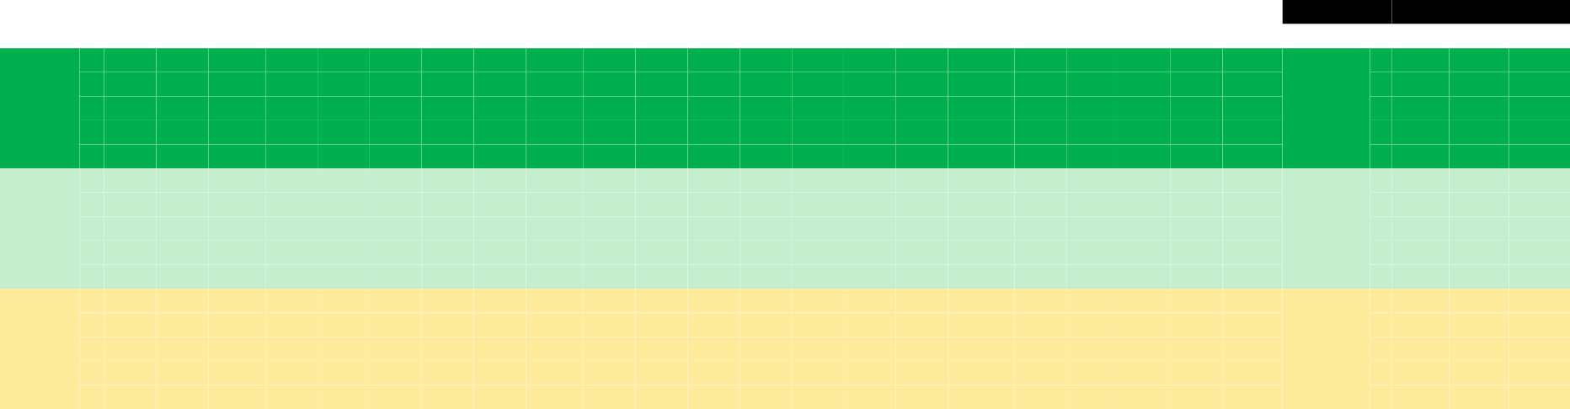




Lifetime OER Strength Chart
TAB D
Director for Strategy and Integration
XO to Deputy COS Army G4
Executive Officer
BDE Deputy CDR
Platoon Leader
Battle Captain
Aide-de-Camp
CLC 3 Student
Asst. BDE S4
Company CDR
Company CDR
Fellowship
Fellowship
Aide-de-Camp
RPOE CDR
BDE S4
BN SPO
BN SPO
BN XO
BN XO
BDE S3
BN CDR
BN CDR
BDE CDR
Position Held
ILE
Position Held
Grade
Company Grade Officer
Field Grade Officer
MAJ MAJ MAJ MAJ MAJ MAJ MAJ (P)
Strategic Leader COL COL COL (P)
Rank
2LT 2LT 1LT 1LT(P) CPT CPT
CPT CPT CPT(P) MAJ
LTC LTC LTC LTC LTC (P)
Rank
Most Qualified (limited to 49%)
5
5
4
Multi-Star ₄
3
Potential
2
(limited to ³
1
24%)
2
5
1
4
Promote ⁵
4
Highly
to BG (limited 3
Qualified ³
to 26-
49%)
2
2
1
1
5
5
4
4
Qualified 3
Retain as ₃
2
Colonel
2
1
1
Not QualifieSdENIOR RATER COMMENTS
(in descending order)
•Enumeration: 1 of ..., the best of..., / top 5% of…..
•Promotion (When): Now!, Below Zone, Ahead of Peers, with peers, promote
•School (When): Now!, immediately, earliest as possible, send now, select now
- Field Grade: Resident ILE / SSC
•Command (When): Now!, immediately, will, select for…, must select for…., groom for….
(identify type of command – tactica (BSB/CSSB), operational, strategic (AFSBN/AFSB) or training
•Potential: Unlimited potential to serve at the highest command levels of our Army (BN, BDE, ESC, TSC, etc.)

Slide 14
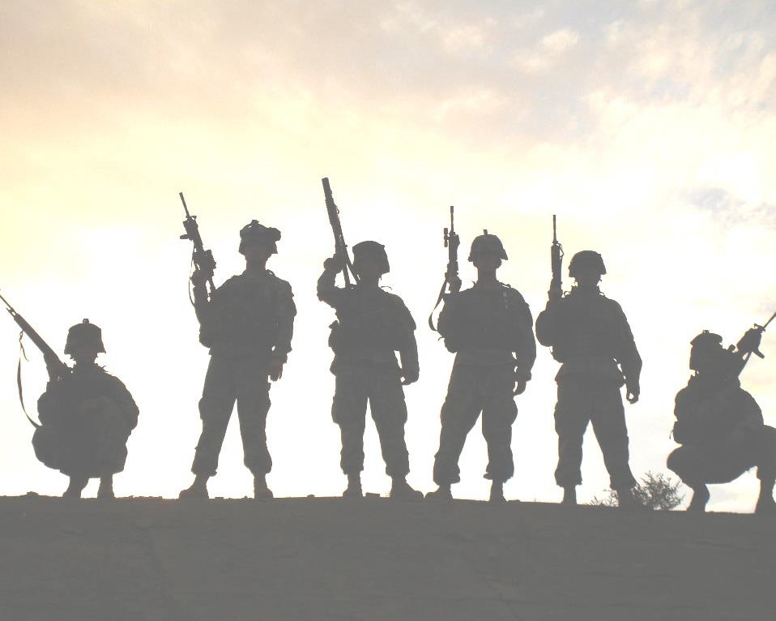

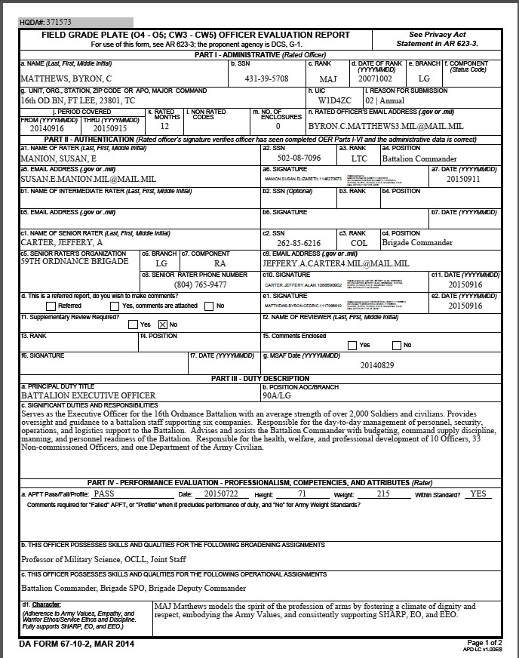

TAB E
Officer Evaluation Report
(DA Form 67-10-2)
TAB E
xxx-xx-xxx
OER Comments
(Front Page)
CHARACTER
Must address:
  Army Values
  Empathy
  Warrior Ethos
  SHARP
  EO/EEO

Slide 15


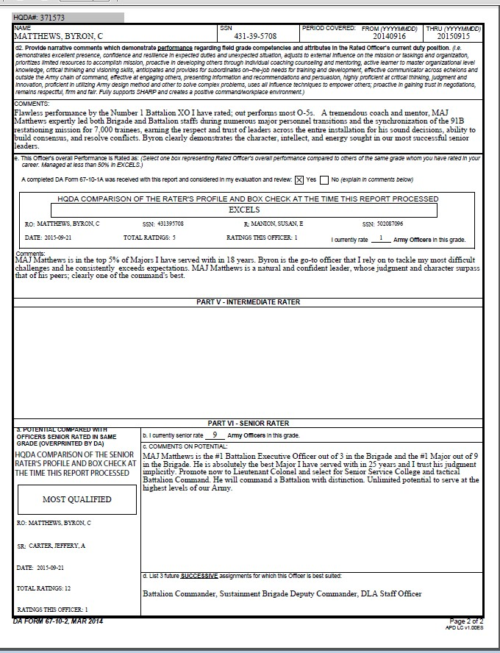


TAB E
Officer Evaluation Report
(OER)
TAB E
OER Comments
(Back Page)
RATER COMMENTS
PERFORMANCE
Must:
✓ Enumerate (1..2..3.. of )
  Compare against peers
  Show outstanding performance
OER Comments
(Back Page)
SR. RATER COMMENTS
POTENTIAL
Must:
✓ Enumerate (1..2..3.. of )
  Compare potential against peers
  Address promotion & when
  Address Command & when
  Address School
  Show potential & at what level

Slide 16
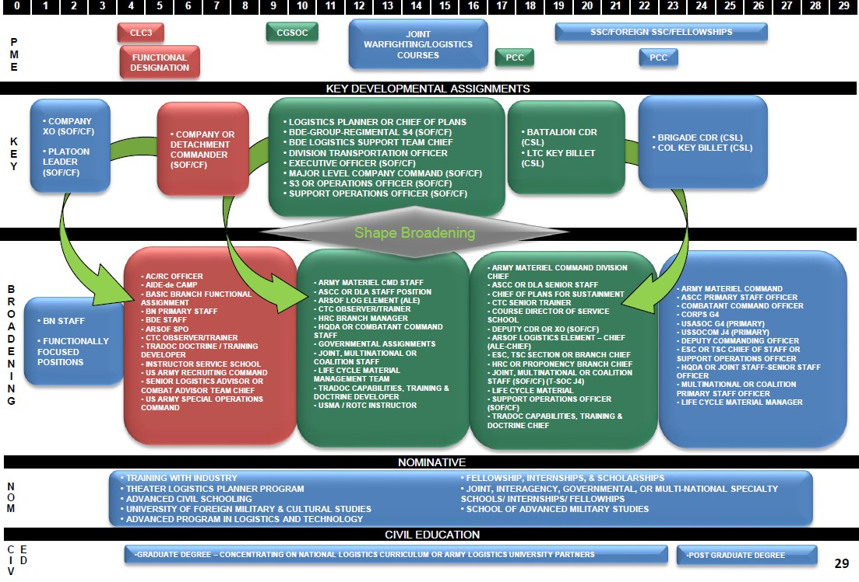
Officer Education & Assignment Timeline
You are your best career manager!

Slide 17
















Example 1: Officer Career / Family Event Plan
TAB F
2LT
1LT CPT
PZ MAJ
PZ LTC
PZ COL
Total Service
10 11 12 13 14 15 16 17 18 19 20 21 22 23 24 25 26
27
28
29
30 31 32 33 34 35
AFCS
0
1 2 3 4 5 6 7
8
9
10 11 12 13 14 15 16
17
18
19
20 21 22 23 24 25
Calendar Yr
1998 99 0
01 02 03 04 05 06 07 08 09 10 11 12 13 14
15
16
17
18 19 20 21 22 23
Years of Mariage
7 8 9 10 11 12 13 14 15 16 17 18 19
20
21
22
23 24 25 26 27 28
Soldier (Age)
34 35 36 37 38 39 40 41 42 43 44 45 46
47
48
49
50 51 52 53 54 55
Child 1 (Age)
4 5 6 7
8
9
10 11 12 13 14 15 16
17
18
19
20 21 22 23 24 28
Child 2 (Age)
0 1 2 3 4 5
LOGISTICS OPS PLANS OFF
6
7
8 9 10
MILITARY CAREER
11 12 13 14 15
JOINT ASSIGNMENT - DLA STAFF
16 17
DIV G4
18 19 20 21
OBC
S&S OFF (SPO)
PLT LDR / XO
S&S OFF (D)
BN S3 (D)
SUST BDE SPO / BDE XO
BDE CDR
TRANS OFF
BDE S3
BN SPO (D)
DEP CDR SUST BDE
S&S OFF
CO CDR
ILE
BN CDR
BN S4
LOGISTICS MANAGER (SPO)
COURSE DIR INSTR/WRITER
COMBAT TRNG CTR SR LOG O/C
CLC3/CAS3
SUBSISTENCE OFF (SPO)
CHAIRMAN
SSC / ICAF
FAMILY EVENTS
MARRIED
START 1ST BOOK
PUBLISH 1ST BOOK
PUBLISH 2ND BOOK
BIRTH 1ST SON
BIRTH 2ND SON
START 2ND BOOK
REITIREMENT PLAN (FOC)
SPOUSE FINISHES AD
RETIREMENT PLAN (IOC)
CHILD 1 - GRADUATES HS
COLLEGE FUND - CHILD 1
SPOUSE FINISHES BS
CHILD 1 - STARTS COLLEGE
PURCHASE TIME SHARE
BUY 1ST HOME
CHILD 2 - STARTS HS
COMPLETE MASTER'S
LEGEND
Total Service Years
Active Federal Commissioned Service (AFCS)
Calendar Year
Complete
Retirement Decision Point
Working
(D) Deployed
Not initiated

Slide 18









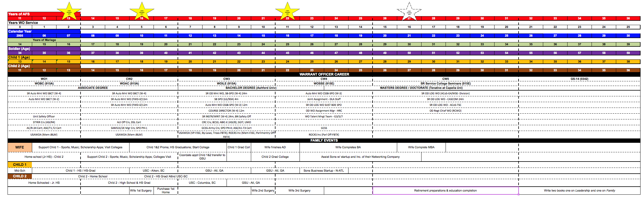
Example 2: Warrant Officer Career Event Plan
TAB F

Slide 19

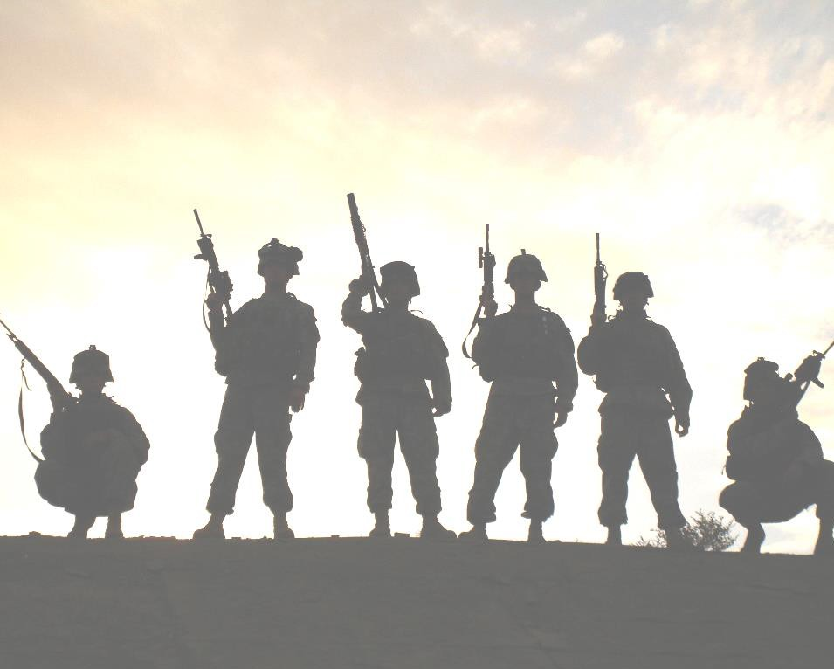




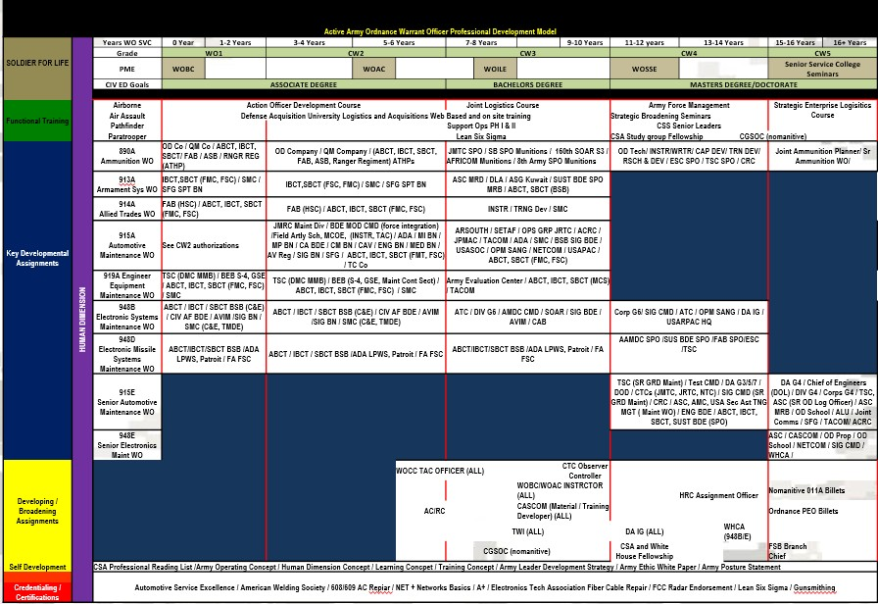
Example 3: Warrant Officer Career Event Plan
TAB F
WO1
CW2
PZ CW3
PZ CW4
PZ CW5

Slide 20



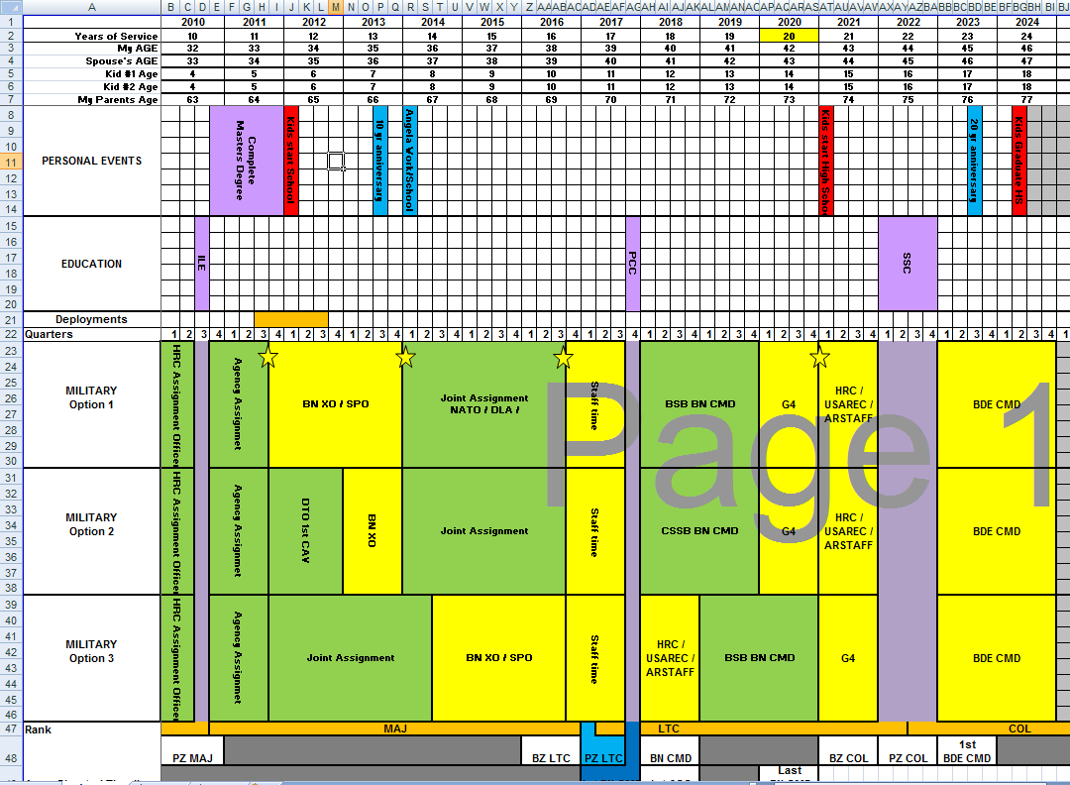
Example 4: Officer 5 Year Plan
TAB F

Slide 21

Post- CCC Assignment Preferences:
Fort Sam Houston (PA School)
Tripler, HI (COA 2)
Fort Bragg (44th MED BDE)
Germany
Fort Bragg (82D ABN DIV)
Example 5:
5 Year Plan
1LT John DOE
Post- Company Command Broadening Preferences:
LTHET (Masters Healthcare Admin)
ILE
TAB F
YG 2009
OTSG
Aide-de-Camp
As of: 24 July 2016
Primary GOAL: Become an Army Physician Assistant Dream Job: Deputy Commander of Administration
Define Success: LTC in 20 yrs having supported my family & served my country honorably Post Military Goals: Obtain Masters Degree in Health Care Admin/Masters in Physician Assistant
NOV SEP JAN MAR MAR MAR NOV NOV NOV
2011 2012 2013 2014 2015 2016 2017 2018 2019
2020
FT BRAGG 82D ABN DIV
OEF
CO CMD
(BROADENING) LTHET/ILE
DOR (CPT) 22 NOV
MAJ BZ
MAJ PZ
Deployment followed by CCC
RC(S) MEDOPS
CC C
Officer (Afghanistan)
Current Career Path
CCC
followed by PA School
BN PA
Flight Surgeon Course
MEDCEN
Section OIC
COA1:
AMEDD
C&S
CCC
PA School
CAB PA
9wks 29 months
2 yrs
6wks
2 yrs
2 yrs
Healthcare Admin Position (TDA
CO
DCA
CCC
followed by CO CMD
COA2:
MEDCOM
CCC Assignment) CMD LTHT/ILE MEDCEN XO MEDDAC OTSG
9wks
24-36
months
18-24 2yrs/10months months
12-18
months
12-18 2yrs months
COA3:
Would do Aide Before/after CCC
CCC ^{Aide-de-Camp} BN Staff CO CMD LTHT/ILE MEDCEN XO DCA OTSG
₄₄TH MED BDE
9wks 12-18 1yr
18-24
MEDDAC
12-18 2yrs
months
months
2yrs/10months 12-18
months
months
Continues Teaching
Child 1: 7yrs
3rd Grade
4th Grade
5th Grade
6th Grade
7th Grade
8th Grade
9th Grade
10th Grade
11th Grade
Wife
2012 | 2013 | 2014 | 2015 | 2016 | 2017 | 2018 | 2019 | 2020
Child 2:
1 y/o
2 y/o
3 y/o
4 y/o
Kindergarten
1st Grade

Slide 22

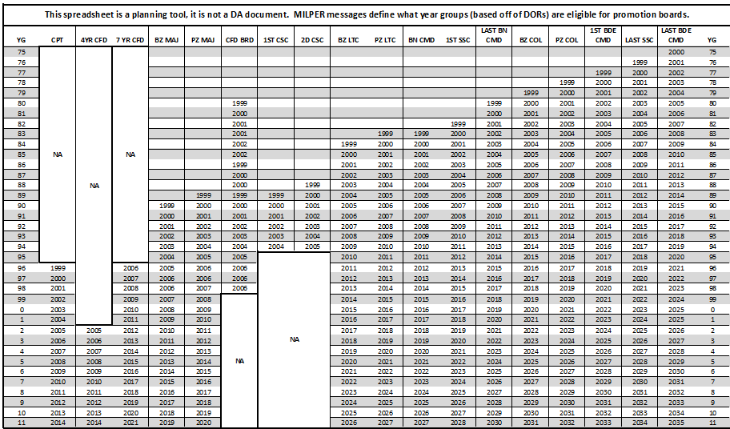
Promotion Board Eligibility

Slide 23

THE PROFESSIONAL BOOK
QUESTIONS
Premier
LOYALTY
DUTY
RESPECT
SELFLESS SERVICE
HONOR
INTEGRITY
PERSONAL COURAGE

