Slide 1
Community Health Services, Inc. Dr. Mauricio Montezuma Nitza Agosto
7/15/17

Slide 2
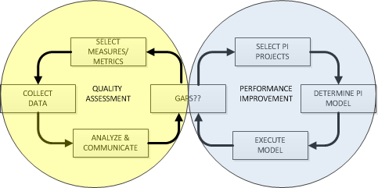
From Quality Assessment to Performance Improvement (QAPI!)

Slide 3
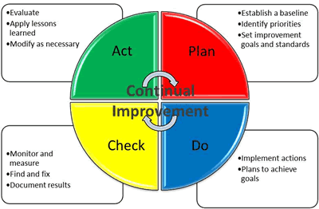
The march towards excellence requires a first step...
SHARE!

Slide 4
PDCA-S Plan, Do Check, Act, SHARE!
Turning Red to Green

Slide 5
Plan
Name the problem/Identify the AIM
Evidence based standards of care?
Heard something at a conference?
Saw something on CNBC?
Talked to a colleague?
Do a little research (Google U??)
Who is doing this better?
How?
Can we improve?
Decide where you want to go?
Where are we now?
How good do we want to be?
By when?
How will we know when we are there? (HOW WILL WE MEASURE??)
What can we do to get there??
Steal shamelessly.
Think small bites.
One or two small changes. Don’t try to solve world peace!

Slide 6
Do
Establish the current state
Available information?
If not, get some!
Data collection, audits
Test your improvement theories
SMALL BITES!
Measure along the way

Slide 7
Check
Impact on department
Easier?
Unanticipated problems?
Impact on stakeholders (patients, other departments??)
What do the numbers say?
Better?
Worse?
The same?

Slide 8
Act
If favorable, stay the course!
If problems, course correct…quickly!!

Slide 9
SHARE!!!
Success!
But more important…
Frustrations
Landmines
Lessons learned

Slide 10
TIME TO SHARE!!
Community Health Services
Ryan White Team

Slide 11
The Core Team
Dr. Montezuma, Clinical Director, Adult Medicine Department
Nitza Agosto, HIV Program Manager
Mildred Diaz, Patient Care Liaison/Medical Case Manager
Elsie king, Medication Adherence Nurse
William Morales, Medical Case Manager
Dennis Gordon, Medical Case Manager
Albert Ruperti, Medical Case Manager
Juan Hernandez, Expanded Testing Coordinator/PrEP Navigator
Dr. Sheikh, Infectious Disease Providers
Joan Ashman, Medical Assistant
Jazmin Malave, Medical Assistant

Slide 12
Plan
Organizational Assessment for Ryan White Programs since 2008
Quality Management Infrastructure
Workforce engagement in HIV Quality improvement
Measurement, Analysis and use of data to improve program
Quality improvement Initiatives
Consumer Involvement
Quality Program Evaluation
Achievement of outcomes
Continue to use this process to evaluate and guide quality Improvement activities.
For 2016
Annual STI’s : Gonorrhea, Chlamydia and Syphilis

Slide 13
Plan for STD Screen Example
Decided where we wanted to go?
Where are we now? –
* Gonorrhea 72%, Chlamydia 69% Syphilis 76%
How good do we want to be?
* Goal: Gonorrhea 85% Chlamydia 85% Syphilis 90%
By when?
* December 2016
How will we know when we are there? When we have reached our goal.
What can we do to get there (improvement theory)?
Pre- order the labs for patients needing screens
Contact patients who need screens to come get their labs drawn.
Use of daily huddles
What might be causing the problem (hypothesis)?
* Patients not going to get their labs or labs not ordered

Slide 14
Do
Establish the current state
* Gonorrhea 72%, Chlamydia 69% Syphilis 76%
Take action
Team will discuss patients needing screens during daily huddles for patients with Medical, Case Management or Map nurse appointments.
Providers pre-ordered screens.
The team continued to run reports weekly for patients needing screens.
Medical Case Managers, Patient Care Liaison and MAP nurse contacted patients to come in to get labs drawn.
Medical Assistants reminded provider to provide patients seen with a lab requisition.

Slide 15
Check
Impact on department
Easier? Unanticipated problems?
Initial work flow changes for providers
More effort with contacting patients that do not received supportive services.
Impact on stakeholders
* Work flow changes for providers
* Obtained Patient outcomes
Measure | Base Line | Goal | Dec 2016
Gonorrhea Screen | 72% | 85% | 91%
Chlamydia | 69% | 85% | 93%
Syphilis Screen | 76% | 90% | 90%

Slide 16
Act
The team will stay the course to maintain the gain!
Consider the process of reviewing performance in June as a way to increase any performance measures that need another level of intervention.

Slide 19
Plus/Delta

Slide 20
Thank you!!

