Slide 1
Innovative Approaches to Improve Macrobenthic Invertebrate Communities Through Stream Restoration
Pat Barber Kevin Tweedy, PE
Acer Environmental Ecosystem Planning and Restoration
San Antonio, TX June 2, 2016

Slide 2
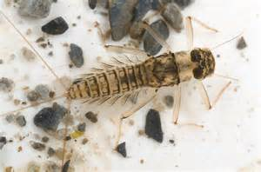
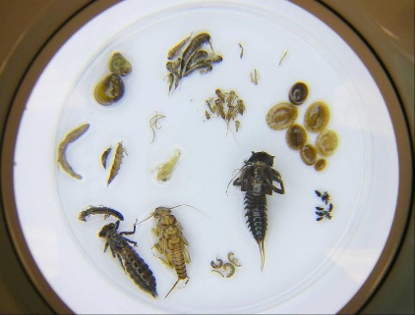
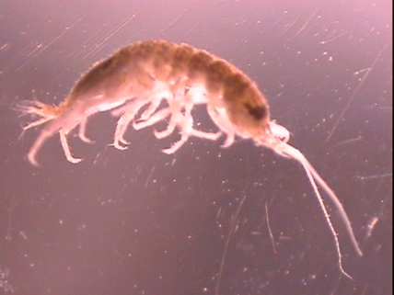
Background
Macrobenthic invertebrate communities include aquatic insects, worms, mollusks, crustaceans, etc. that are important components of stream ecosystems.
Macrobenthics are sampled to gauge the relative health of intermittent and perennial streams.
Notes:
Restoration community has historically taken the approach of if you build it they will come.

Slide 3
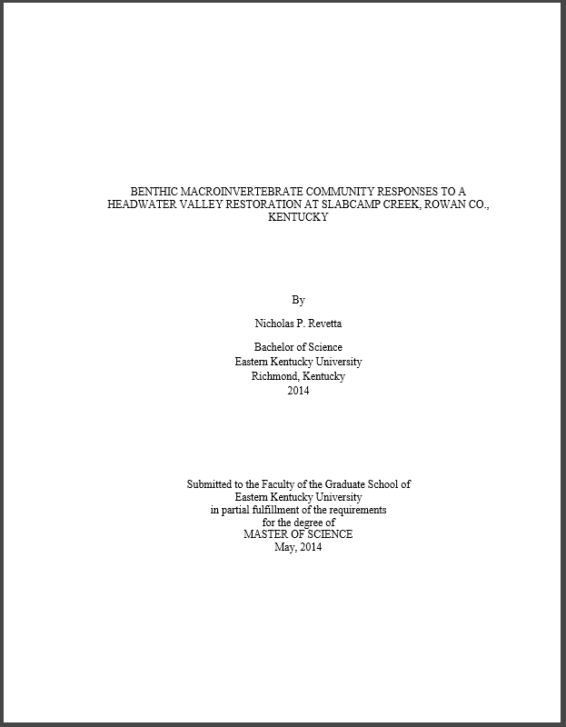
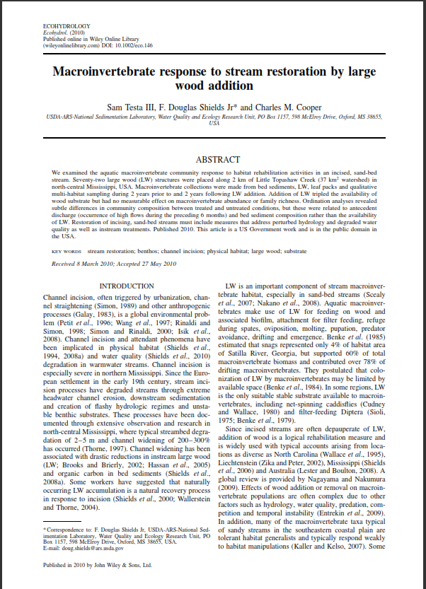
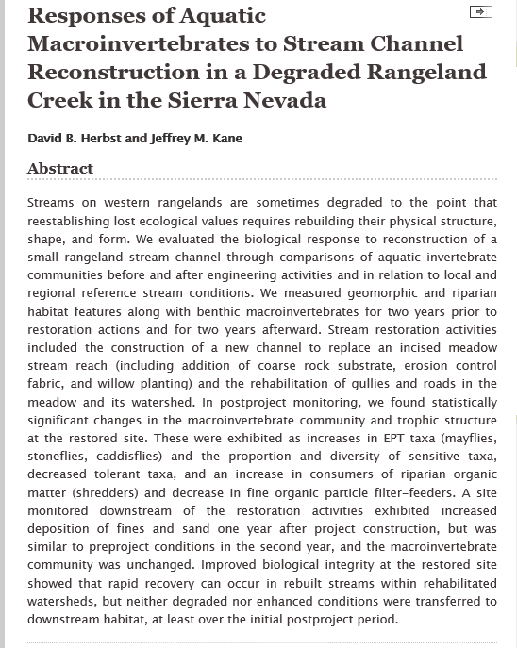
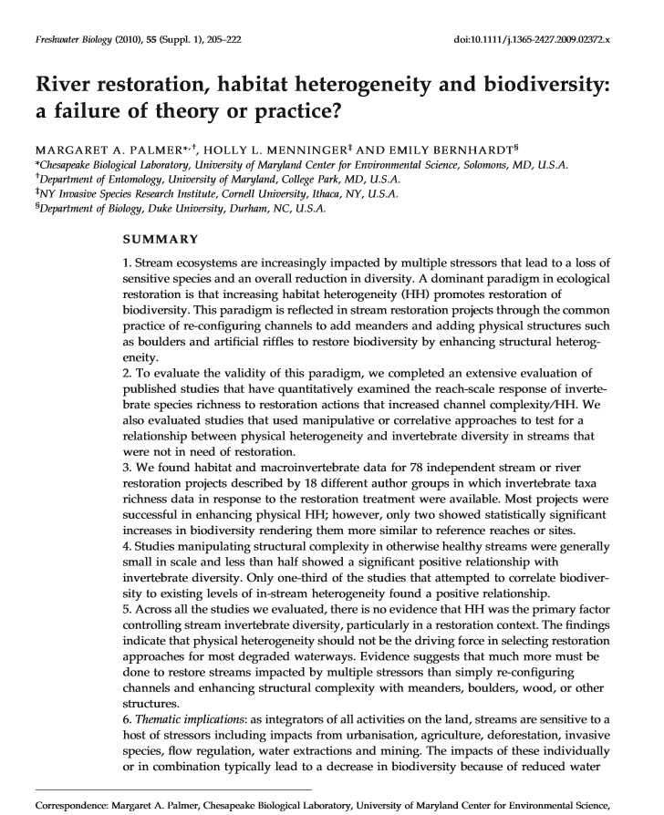
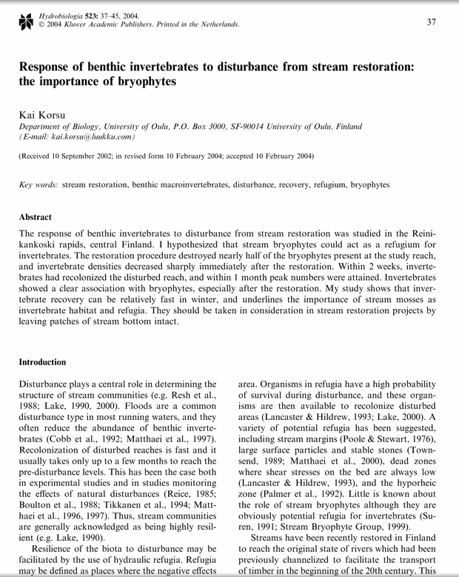
Background
Macrobenthics are also used to evaluate stream restoration projects, with mixed results:
Notes:
The research that is available is mixed. Some projects have shown good improvement, others not so much. What we have done is looked through a lot of this literature, and results from our own projects, and look for approaches and techniques that will improve bug communities.

Slide 4
Background
There is increasing interest in promoting improved macrobenthic communities as part of a stream restoration approach.
Regulatory drivers:
TMDL’s
EPA Stormwater Phase II Rules
Mitigation Projects under CWA Section 401 and 404
2008 Federal Mitigation Rule – replacement of functions
Notes:
Work in previous decade was focused more on stability success criteria, but now more interest and requirements to monitor biology.

Slide 5
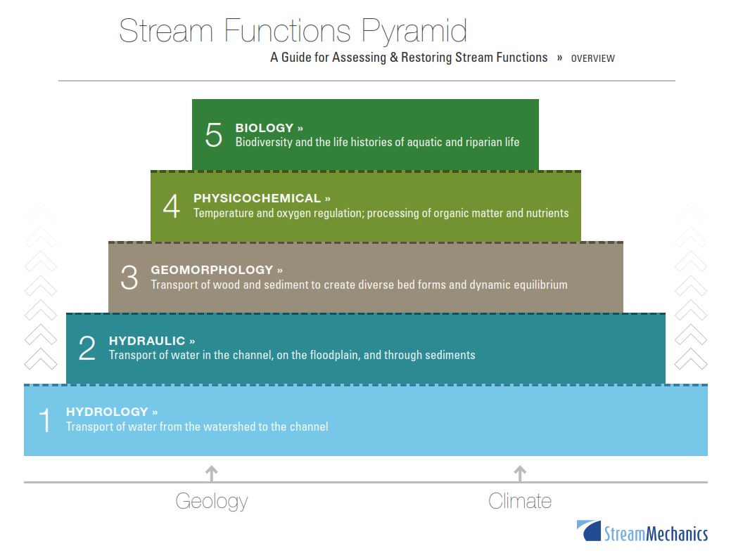
Background

Slide 6
Current Work
Our work is focused on identifying practical and cost effective techniques for the improvement of macrobenthic communities in response to stream restoration.

Slide 7
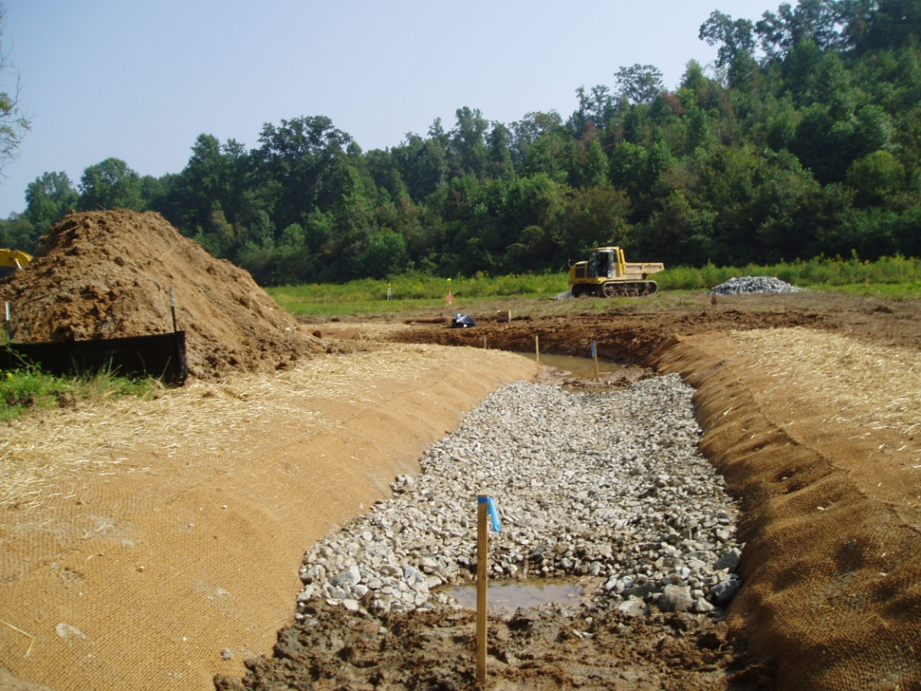
Instream Structures for Stability
Traditional Constructed Riffle

Slide 8
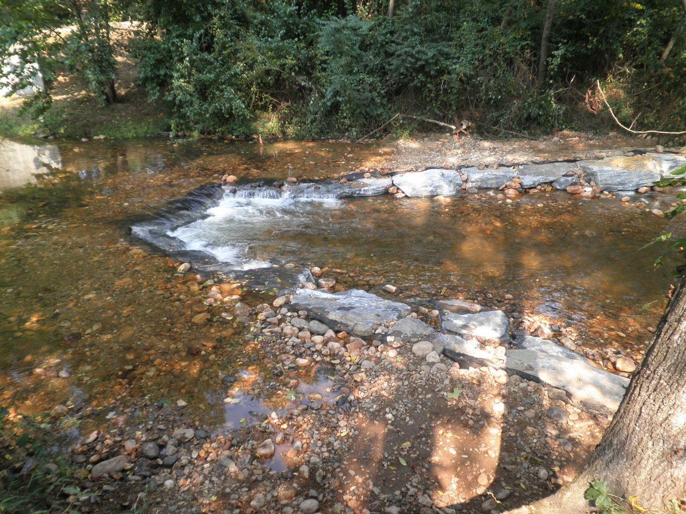
Instream Structures for Stability
Traditional Cross Vane

Slide 9
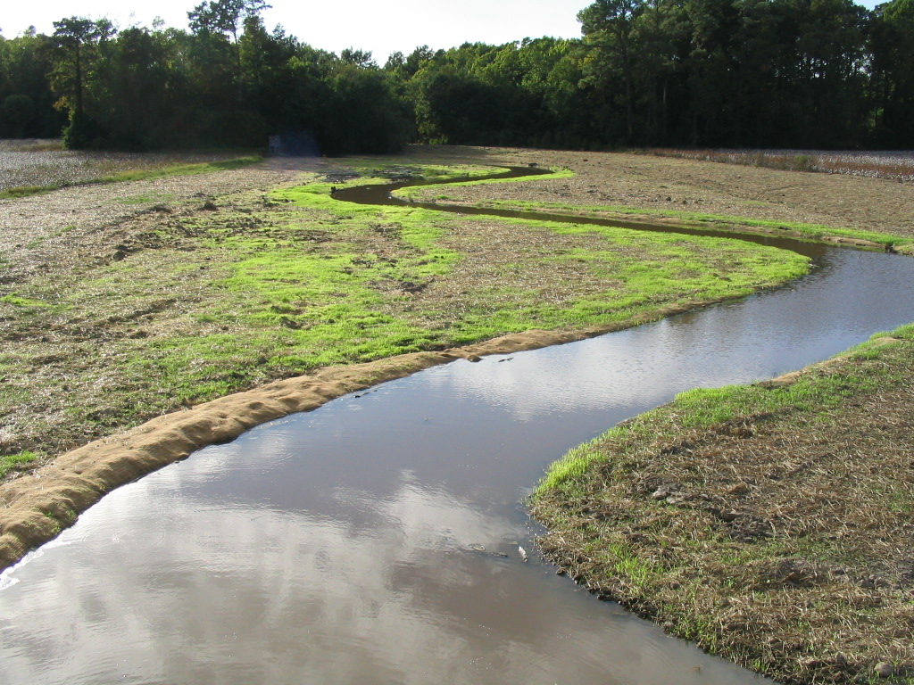
Instream Structures for Stability
Bottomland Channel

Slide 10
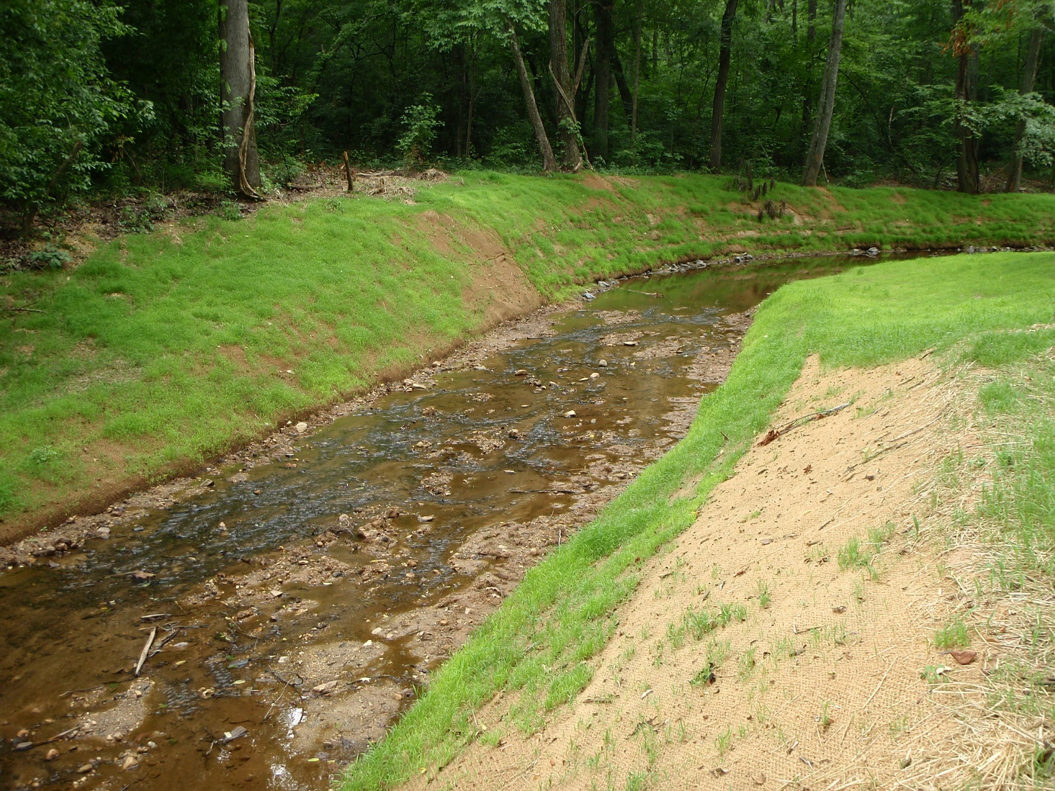
Instream Structures for Stability
Traditional Constructed Riffle

Slide 11
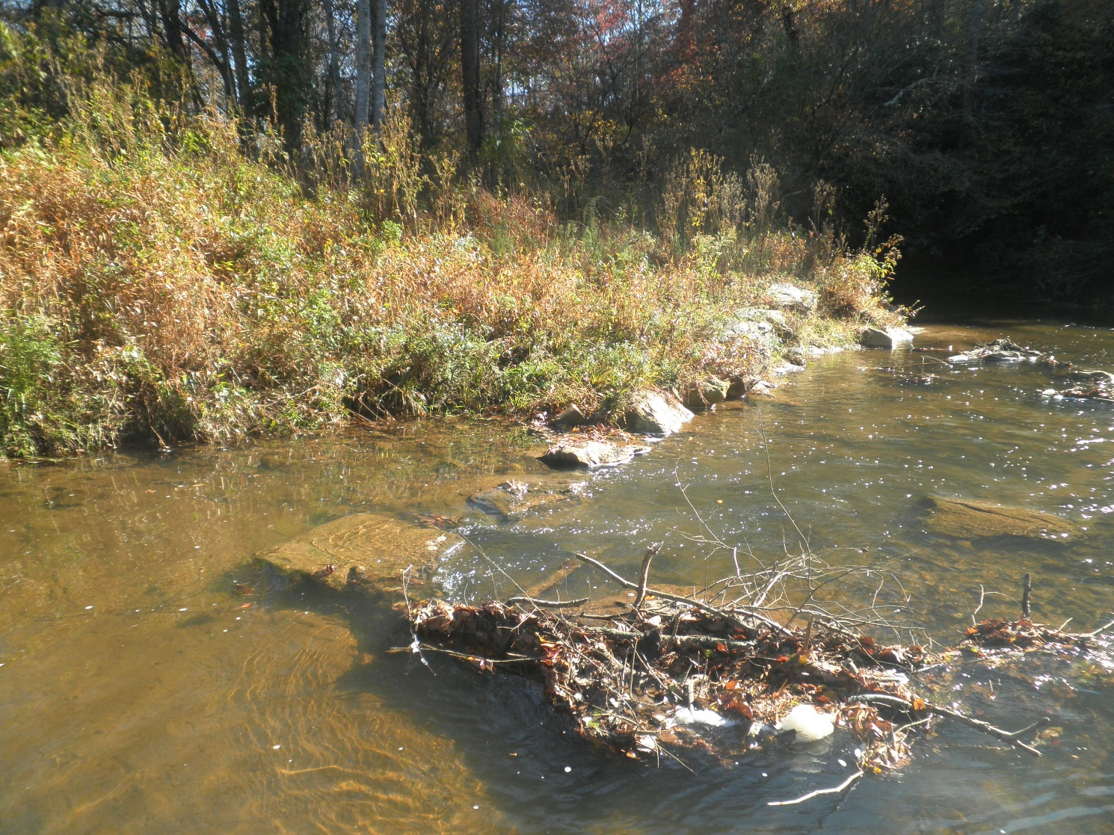
Instream Structures for Stability

Slide 12
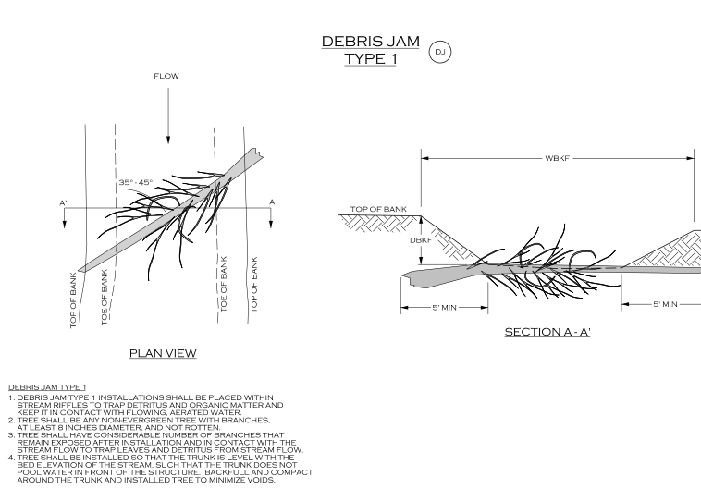
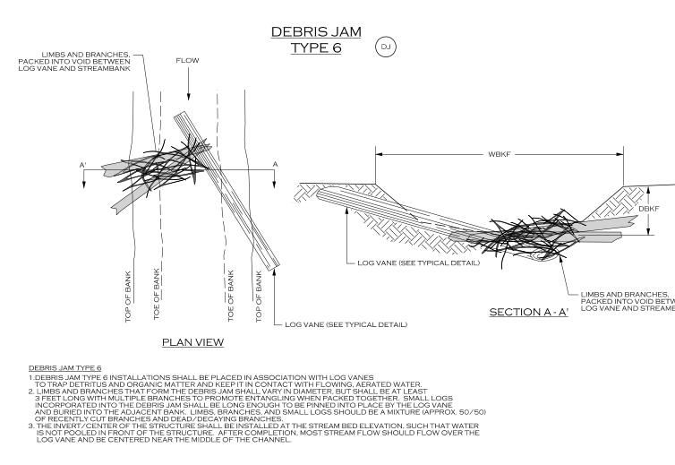
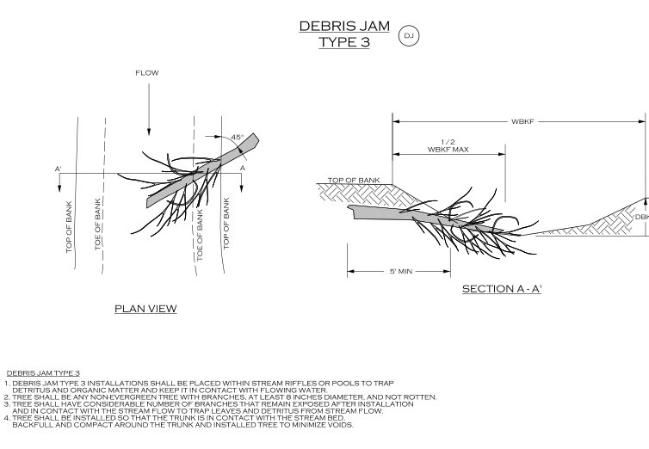
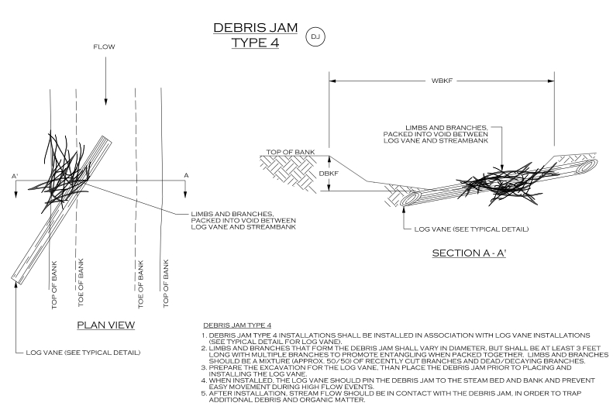
Enhanced Instream Structures

Slide 13
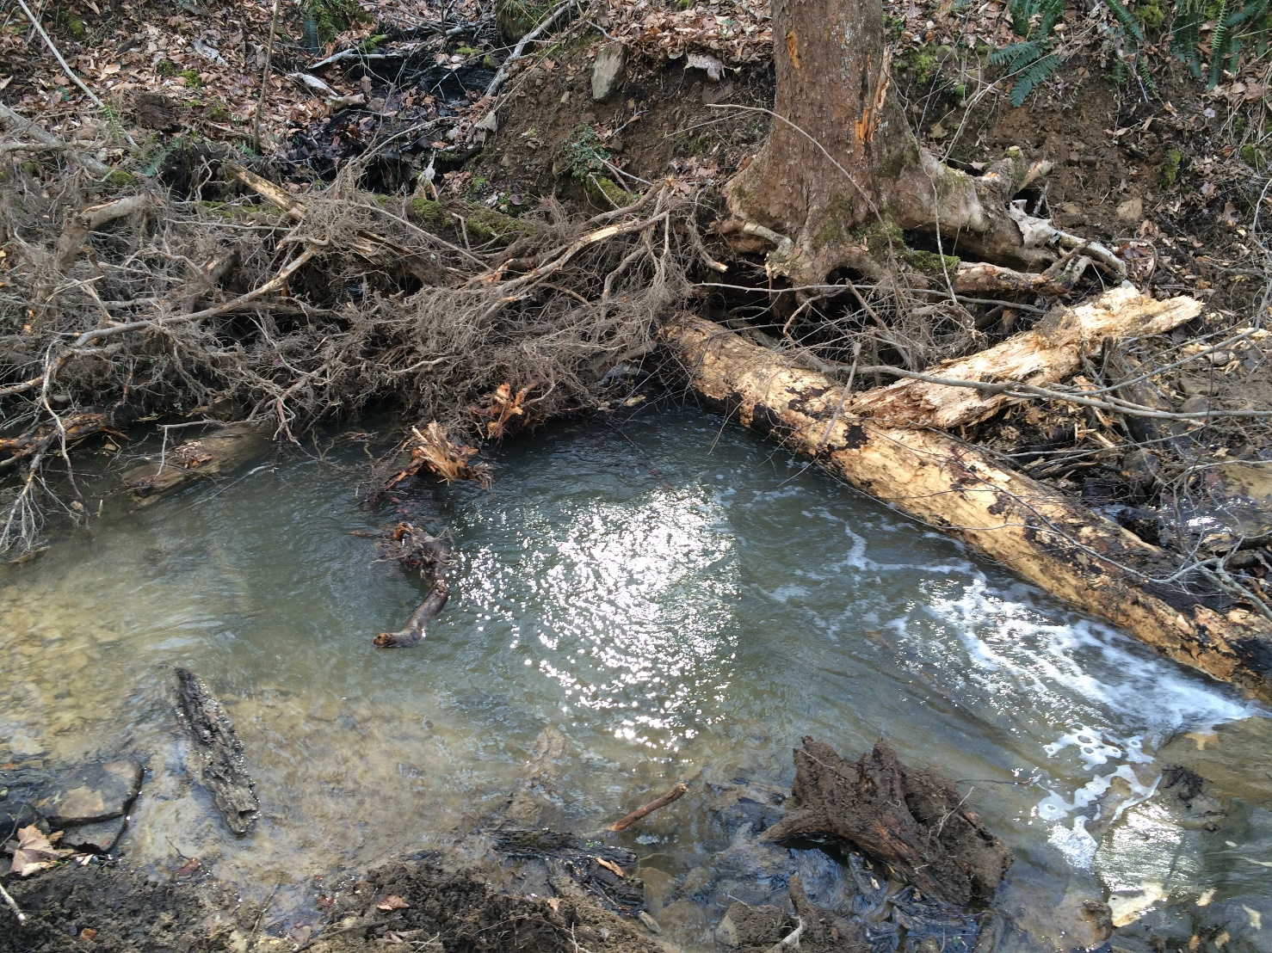
Enhanced Instream Structures

Slide 14
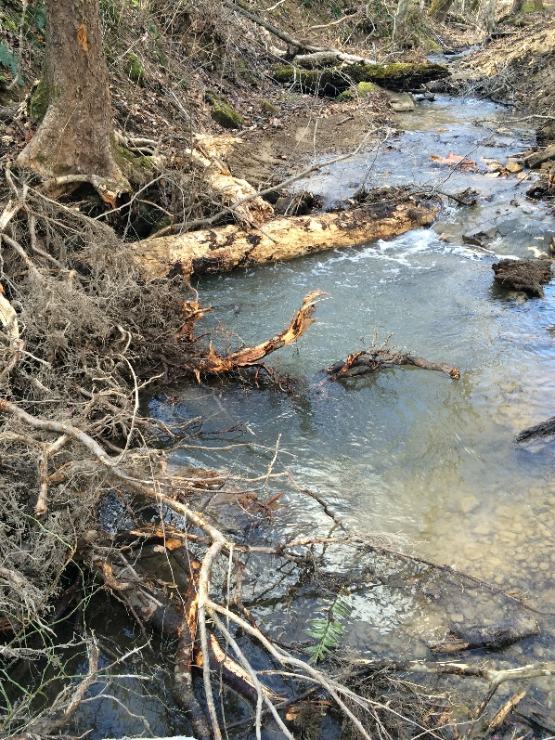
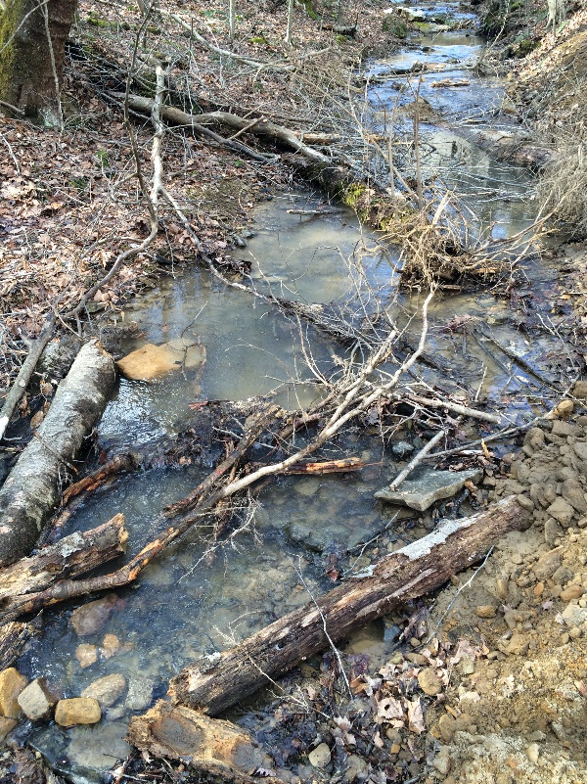
Enhanced Instream Structures

Slide 15
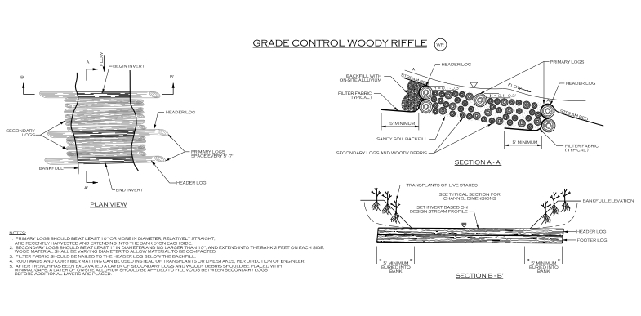
Enhanced Instream Structures

Slide 16
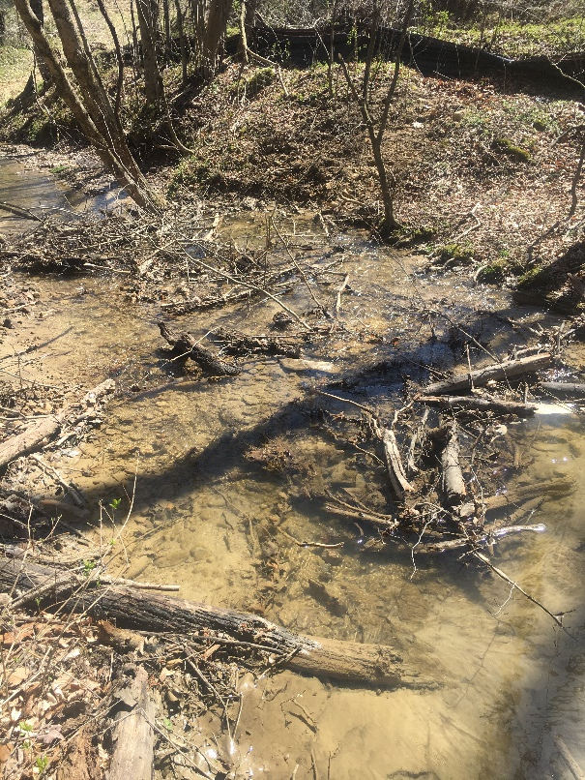
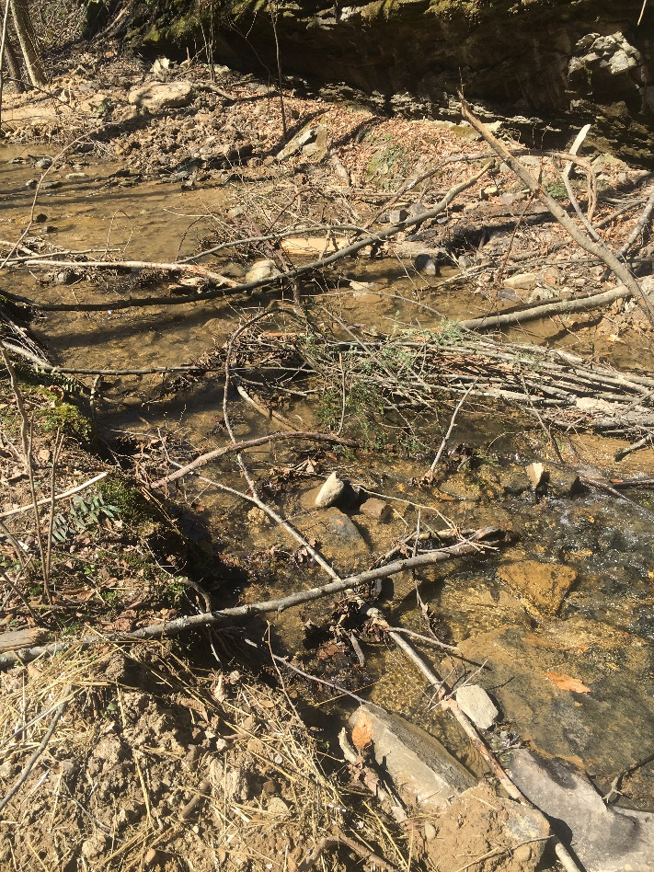
Enhanced Instream Structures

Slide 17
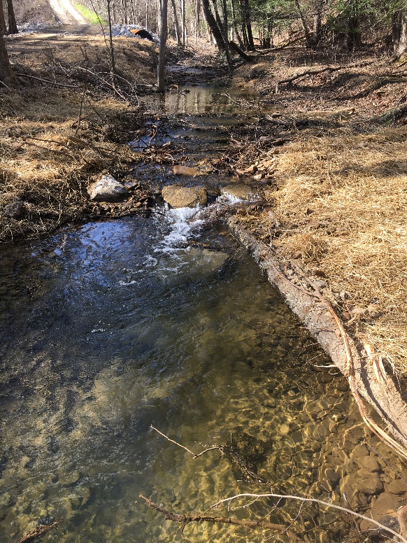
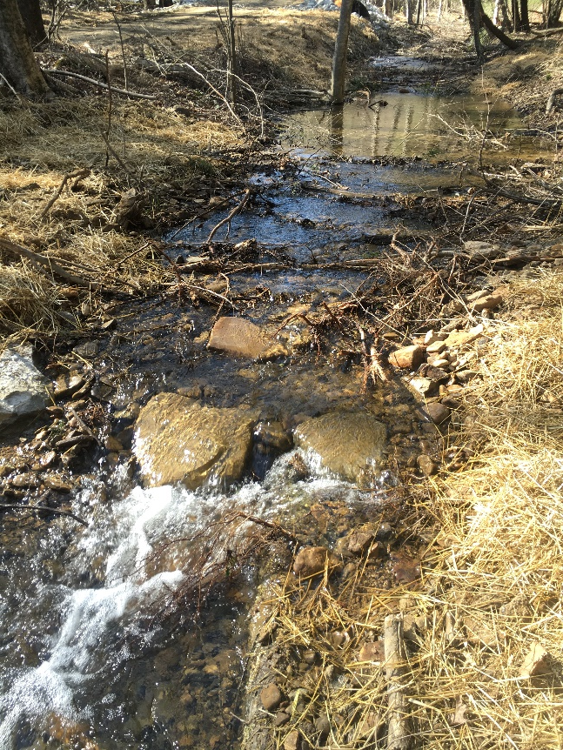
Enhanced Instream Structures

Slide 18
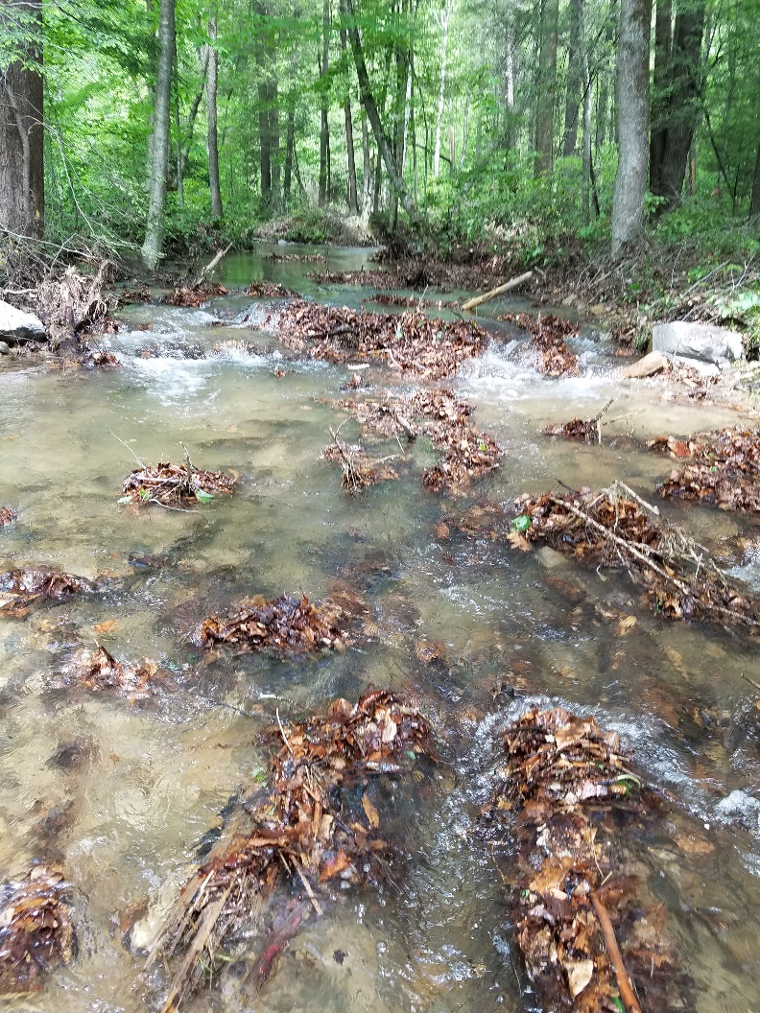
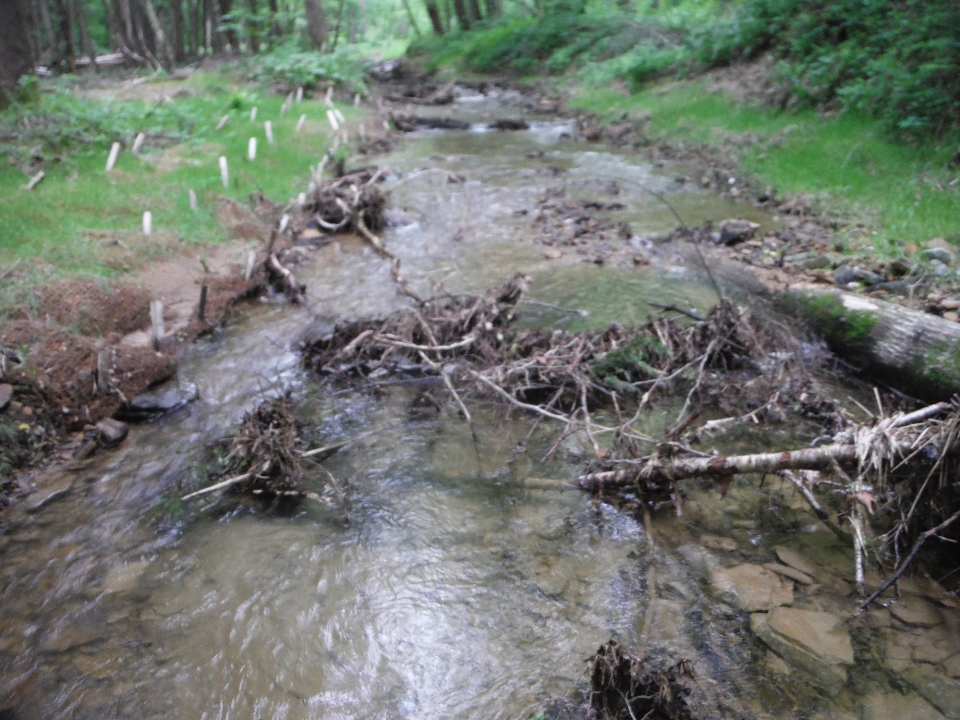
Enhanced Instream Structures

Slide 19
Enhanced Instream Structures
HabiTubes For Stream Restoration
Artificial and natural way to keep leaf pack and woody debris in place for extended time.
A way to move organisms from one stream to another.
Can be used to enhance a struggling system.
Can be refilled.
If left in a stream, the material still offers habitat for organisms.
Place for organisms to hang on in streams with flashy high flows.
Can be a way to add and hold the proper type of organics in a stream.
A way to stop the peak and drop of macrobenthic organisms after a restoration effort.

Slide 20
Enhanced Instream Structures
HabiTubes
Recreates Leaf Pack
Recreates Woody Debris
Provides a Food Source for many MBO’s
Provides Growth Medium for MBO’s
Provides Habitat for MBO’s
Provides stable platform in flashy high flows
Provides Microhabitat for MBO’s
Provides Ecological Lift
Relocation Method for MBO’s
Natural Product
Environmentally Friendly

Slide 21
Enhanced Instream Structures

Slide 22
Enhanced Instream Structures
HabiTubes
Findings
The longer the HabiTubes stay in the water the more organisms utilize them.
During spring and summer the HabiTubes have to be refilled every 6 to 8 weeks.
During the fall and winter materials in the HabiTubes will be consumed at a slower rate.
HabiTubes create a “micro” ecosystem that attracts organisms to their general location.
Early on the May flies tend to stay on the outside of the HabiTubes. If algae is allowed to establish on the HabiTubes, the May fly numbers increase.
Organisms like to nest in the HabiTubes.
Salamanders, crayfish & newts utilize the HabiTubes.

Slide 23
Enhanced Instream Structures
HabiTubes
Findings (continued)
When the HabiTubes are added to a typical Qual IV Sampling Technique the number of taxa found in the sample increases by 30 to 50 percent.
Bioclassification levels have been raised from poor to good and poor to fair/good.
Results are water quality and habitat dependent.
Donor stream effects ecological lift.
Relocations can occur during any time of year.
Provide ecological lift for mitigation projects.
Provide biotic restoration for delisting streams from 303(d) listings.
Restore biotics as required by litigation.

Slide 24
Enhanced Instream Structures
Oviposition Rafts
Many insects lay eggs on the underside of woody structures and rocks.
Utilize the oviposition tendency of insects to lay eggs on structures such as wood and rocks.
Currently testing.

Slide 25
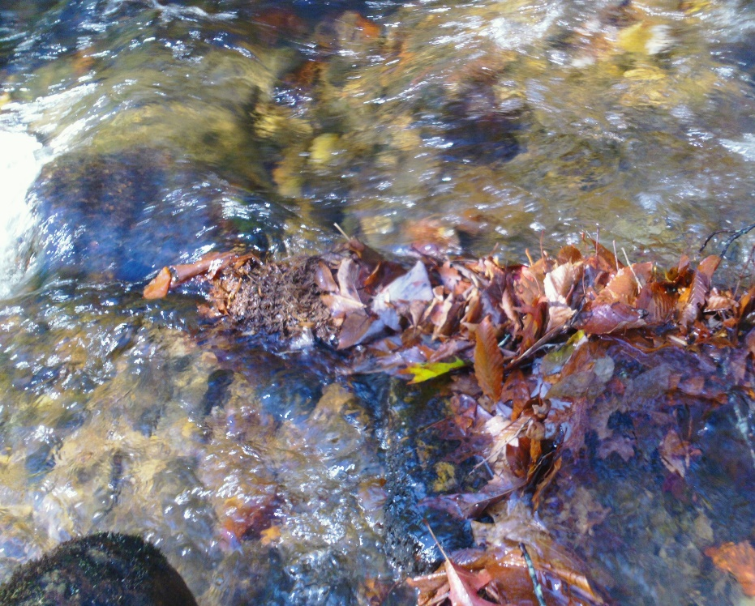
Enhanced Instream Structures
Successful restoration for macrobenthic invertebrates requires:
Restoration of Leaf Pack
Restoration of Woody Debris
Restore Usable Woody Debris
Create Habitat
Create Microhabitat
Add The Right Kind of Usable Organics
Provide Food for Organisms
Promote Fungi Growth
Promote Bacterial Growth

