Slide 1
DAWNS House Directly Assisting Women Newly Sober
MISSION: To provide Safe, Compassionate Sober Housing for Displaced Addicts and Alcoholics in our Community. By means of a guided, structured program that gains successful results.
1 Home/8 beds, In Bend
76 Women Served/Housed in 23 Months

Slide 2
Making an Impact in our Community
100% were either homeless/unemployed/below poverty level
88% Acquired employment within the first 30 days at DAWNS House
DAWNS House is the Only public sober living facility in Central Oregon
86% of all crime in CO is drug/alcohol related
(Oregon.gov)
DAWNS House has stopped criminal recidivism in 75% of our program residents.

Slide 3
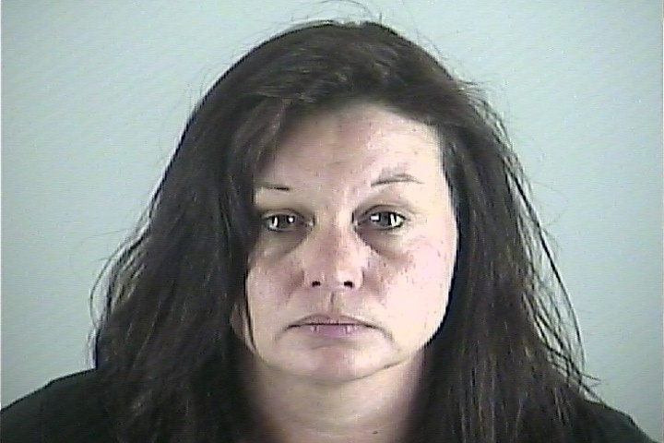
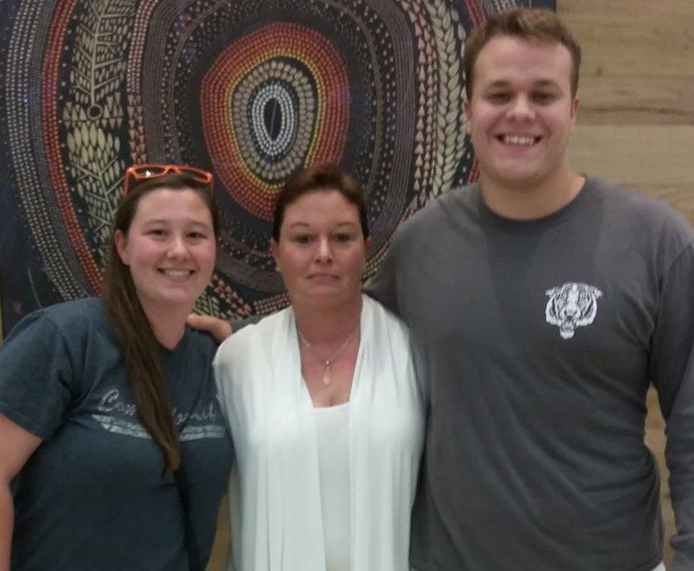
Lynette: A DAWNS House Alumni
NOW:
Years Clean & Sober
Obtained Drivers license and a car
Employed as addictions counselor
Reunited with children
Successfully completed the DAWNS House program and transitioned into independent living
THEN:
Addicted to Methamphetamine
Two Time Felon and multiple arrests
Homeless
Unemployed
Lost Children due to drug use

Slide 4
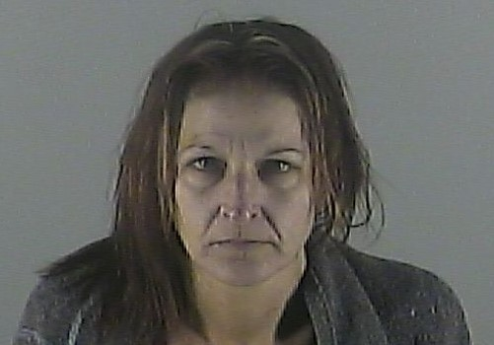
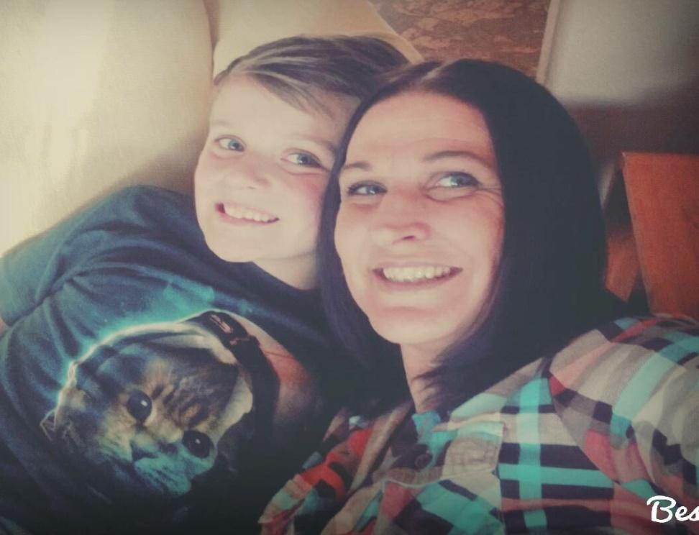
Cheri: DAWNS House Alumni
THEN:
Multiple Felony's with 4 separate prison sentences
Unemployed
Lost child due to addiction
Over 30 arrests
Addicted to Meth/Heroin
NOW:
years sober
Reunited with son
Working in the recovery field
Obtained License & Vehicle
Role model/mentor to women in DAWNS House

